Slide 1
Statewide Master Adjustments Management
SWMA System Training

Slide 2
AA Memo #4

Slide 3
SWMA User Access

Slide 4
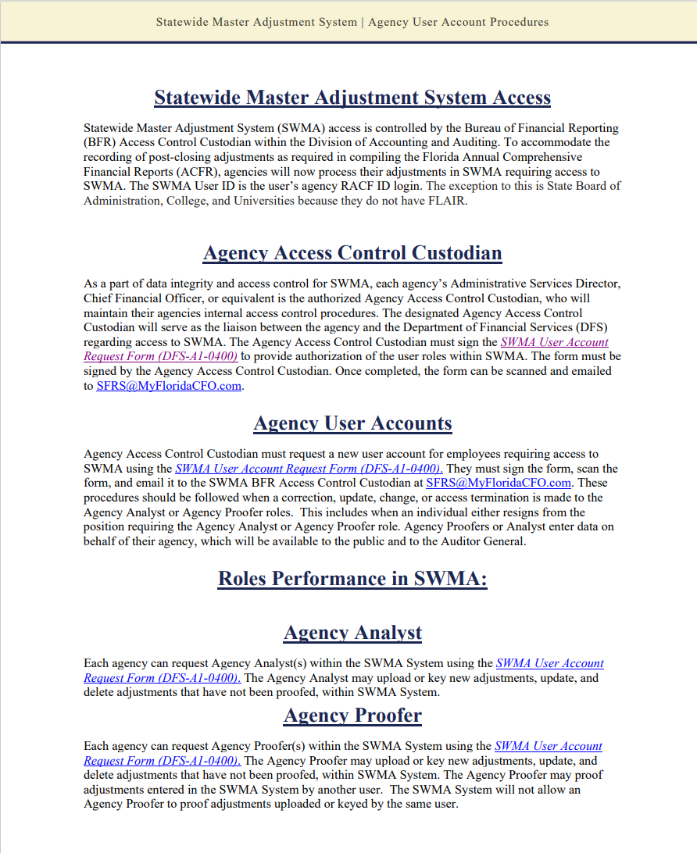
SWMA User Access
SWMA User Account Request Form
Completed request Form must be signed by the Agency Access Control Custodian
Administrative Services Director, Chief Financial Office or equivalent
Two Roles
Agency Analyst
Agency Proofer

Slide 5
SWMA User Access

Slide 6
SWMA User Access Request Form

Slide 7
Authentication & Authorization

Slide 9
Option 2
Option 1

Slide 10
Option 1
Upload Multiple Files

Slide 12
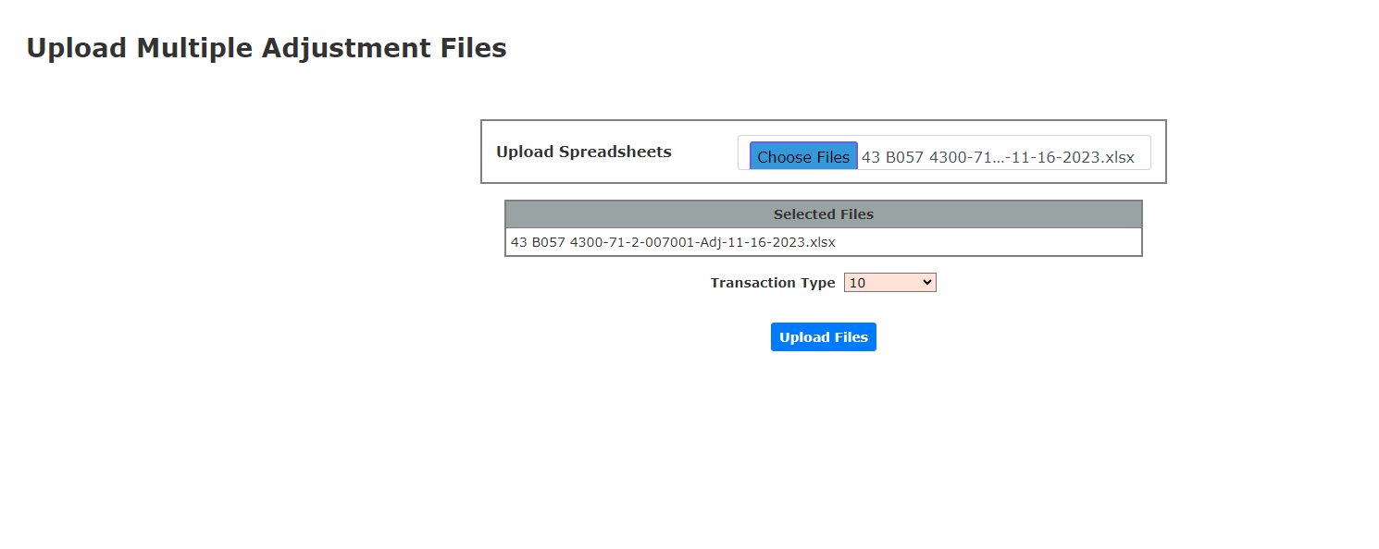

Slide 15
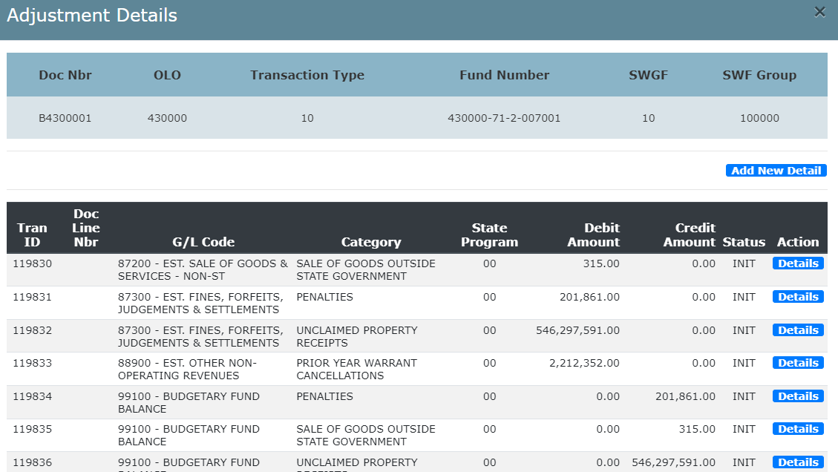

Slide 16
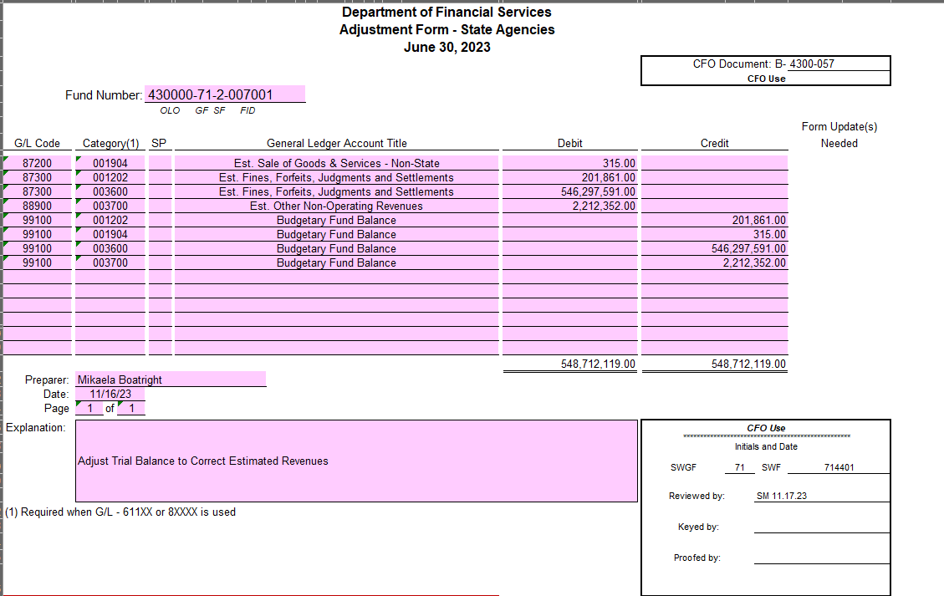
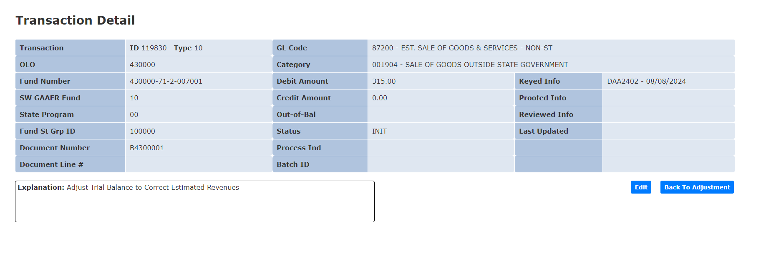

Slide 18
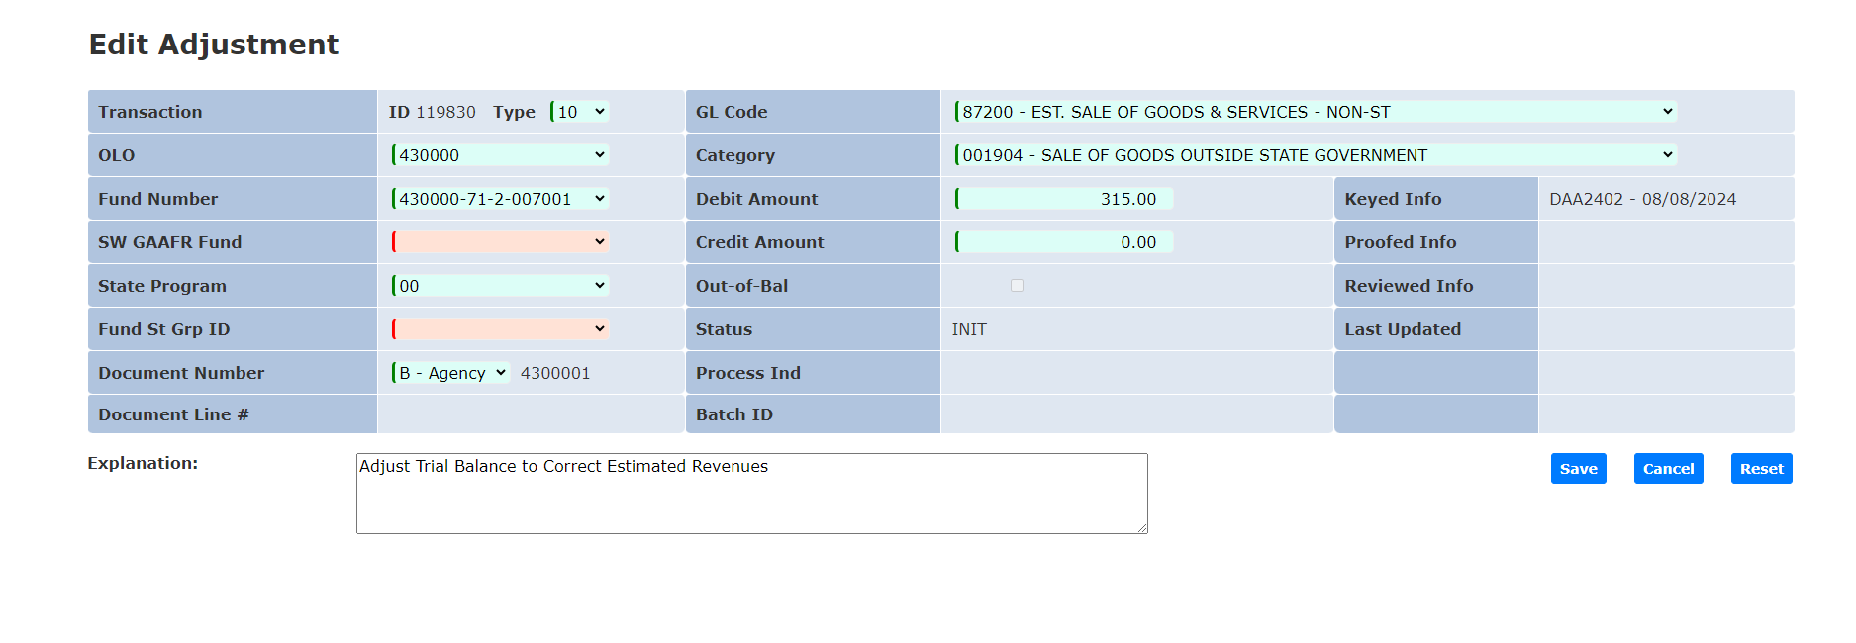

Slide 20
Option 2
Manual Entry /Single File

Slide 21
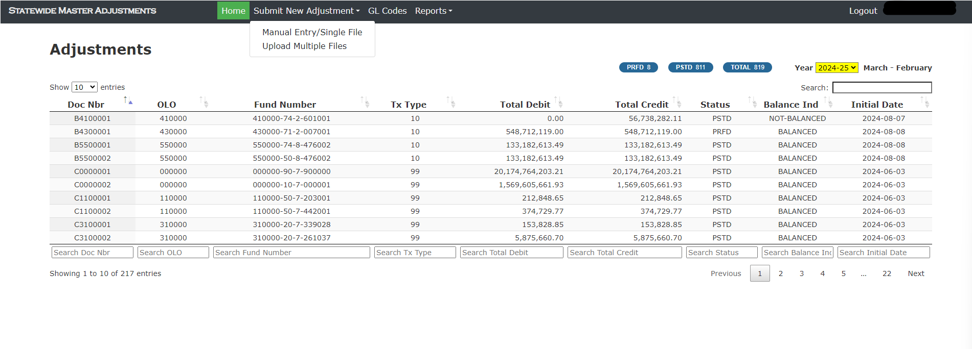

Slide 22
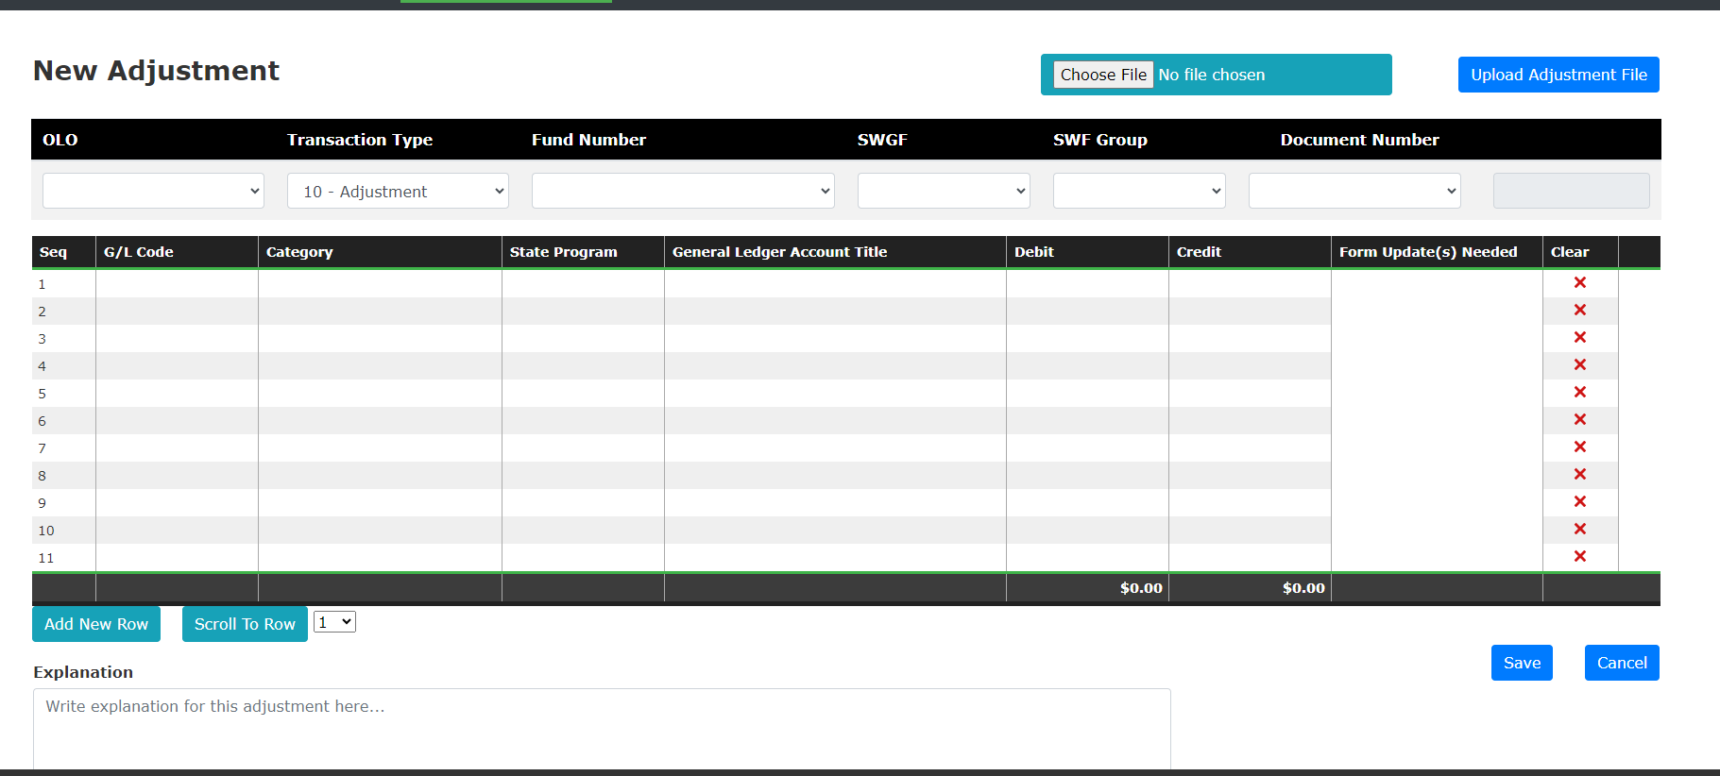

Slide 23
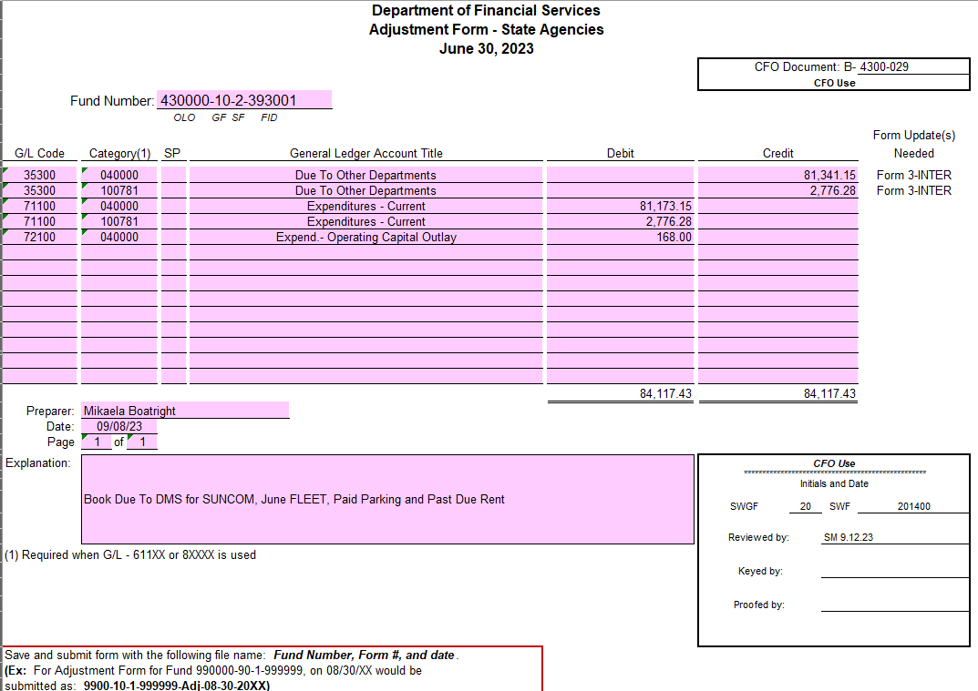
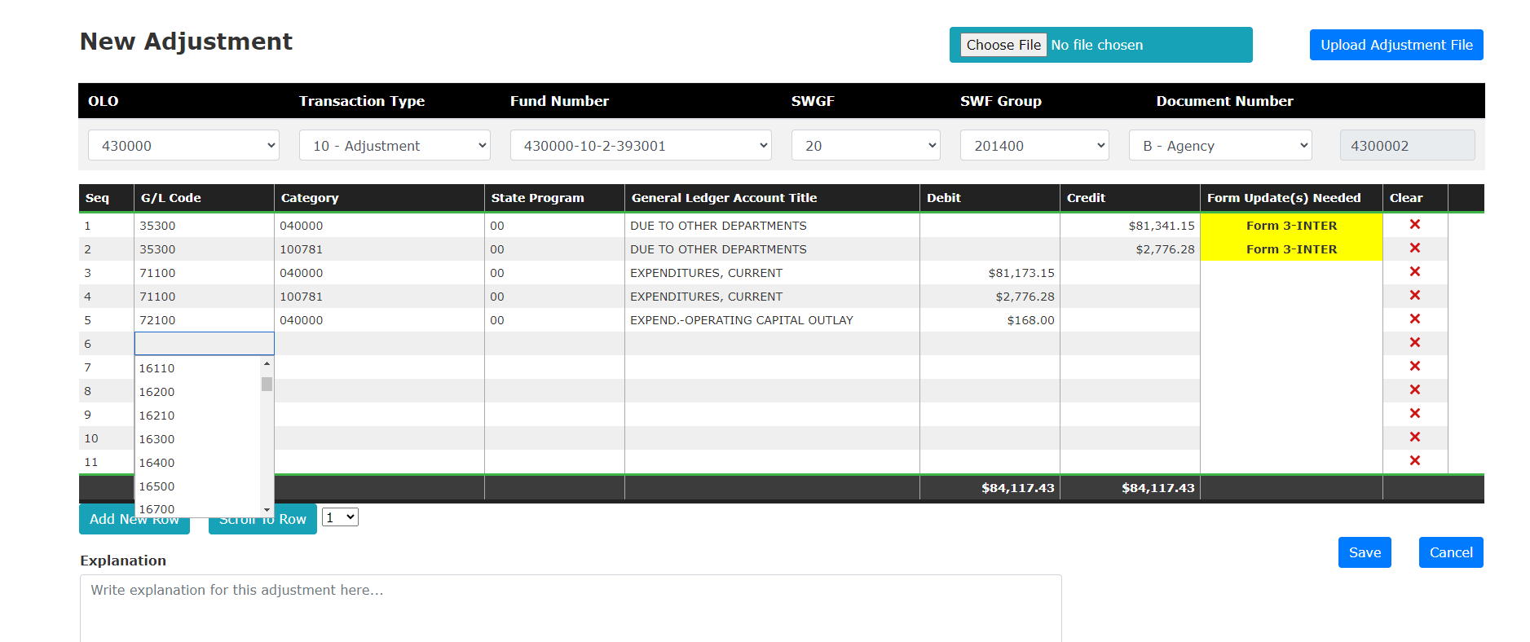

Slide 24
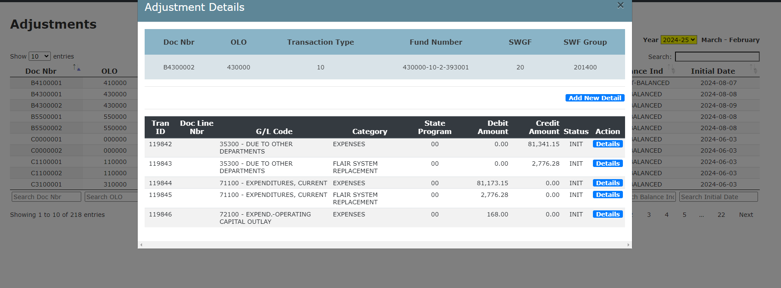

Slide 25
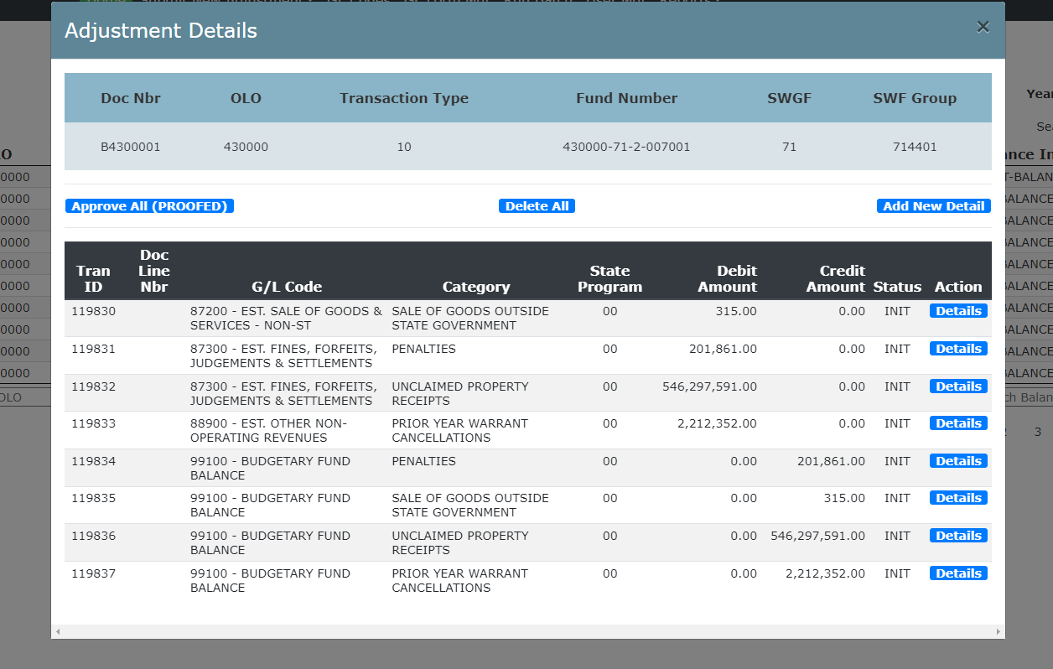
Proof Adjustment

Slide 27
Any Questions?
Notes:
Any questions?
We will take a 5-minute break.

Slide 28
General Questions can be sent to SFRS@myfloridacfo.com
Notes:
Here is the contact list should you have questions during the compilation process.

