Slide 1


DATA & REPORTS
DATA & REPORTS
in Florida PALM and the Data Warehouse
in Florida PALM and the Data Warehouse
Every division/office relies on timely data, and after Florida PALM Go-Live, it will be critical for end users to know how to access that data. After Florida PALM Go-Live, FLAIR interfaces, Information Warehouse, FLAIR RDS, and FLAIR@DFS will be retired.
End users will be able to access the data held in Florida PALM through standard reports and queries, custom queries, and through Agency and Enterprise Business Systems. The information in the Data Warehouse can also be accessed through standard reports and custom queries.
Testing your reporting capabilities during User Acceptance Testing (UAT) will be key to confirming you can access needed data after Go-Live. You will have an opportunity to do this in a dedicated testing environment during UAT.
FLAIR is composed of four components: Central Accounting, Departmental Accounting, PYRL, and Information Warehouse.
Information Warehouse (IW) is a reporting subsystem within FLAIR that allows users to access information extracted from FLAIR and, in limited instances, information from certain systems external to FLAIR.
Florida PALM is an integrated, enterprise resource planning solution that includes Financials (FIN) and Human Capital Management (HCM) which will replace all components of FLAIR and has already replaced Treasury’s Cash Management System.
The Data Warehouse/Business Intelligence (DW/BI) will replace IW. The DW/BI is a central repository of data, reports and reporting tools and will contain a subset of Florida PALM data and FLAIR historical data.
Florida PALM Module Interactions
The following diagram illustrates the organization of data inside Florida PALM and the relationships between the General Ledger (GL) and Commitment Control (KK) ledgers with the Source Modules. Understanding this model will help you know where best to find your data.
In Florida PALM, the GL and KK Modules serve as a central hub, connected to the remaining smaller, decentralized Modules. Each Source Module focuses on certain types of activities and transactions, and this is where the greatest amount of detail is available for those items. For example, Accounts Payable will have the details about voucher/invoice and payment transactions. The Accounts Receivable Module will have the details for deposits, returns and accounts receivable.
(May 2025)

Slide 2
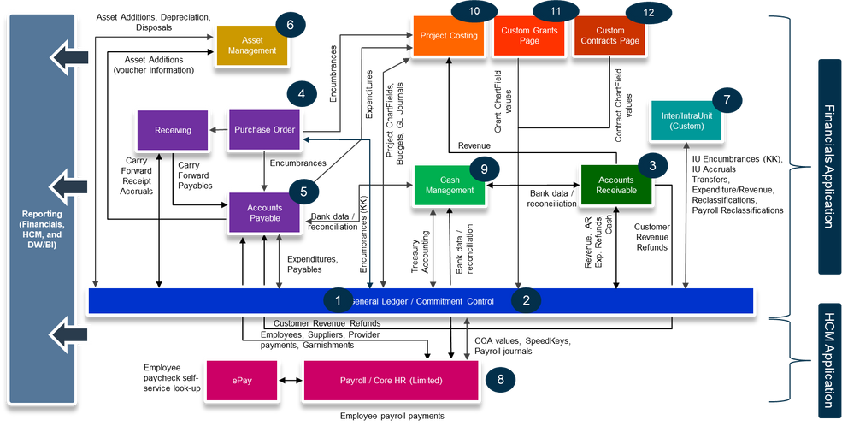
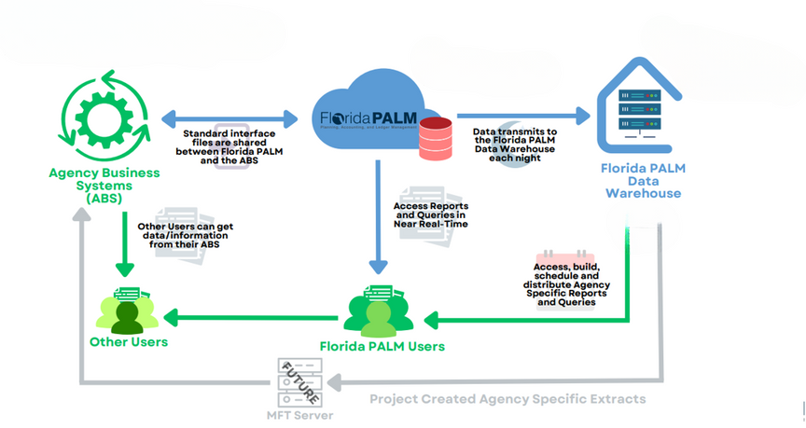
Data Flow & Interfaces
This diagram outlines paths for agencies to get data from Florida PALM or the DW/BI.
  Agency Business Systems (ABS) and users are represented in green.
  Florida PALM is the blue cloud in the middle.
  The gray lines represent future functionality.
Available data/info
  Reports & Queries
Available data/info
  Reports & Queries
  PLUS: Self Service Queries & Extracts
2

Slide 3
Florida PALM and the DW/BI will work in tandem, with the following interactions:
  Florida PALM & DW/BI: Florida PALM will send data to the DW/BI on a nightly basis.
  Florida PALM & Enterprise/ABS: Data is sent and received via standard interface files.
  The DW/BI & ABS: The DW/BI will not interface with ABS at Go-Live.
At Go-Live, users will be able to use query filters to target specific information in the DW/BI and even schedule queries to run as needed.
Reporting Solution Comparison
Reporting Solution | Florida PALM | Data Warehouse/ Business Intelligence
Audience | Users responsible for day-to-day operations | Users responsible for analytical, statutory, historical, and strategic reporting
Florida PALM Data | All Florida PALM Data | Completed Florida PALM Transactions for AP, AR, IU, AM, GL , KK, and Payroll
Data Refresh | Real or Near-Real Time | Nightly data refreshes
Formats | Excel (.xls), .csv, .and .pdf | Excel (.xls), .csv, .and .pdf
Report Subject Areas
Unlike today, DW/BI reports are organized by subject area with logical groupings to support drag and drop reporting. DW/BI reports are used to analyze completed transactions, while Florida PALM reports are used to manage transactions in the approval workflow or not yet complete. DW/BI Reports will be available for the following Modules:
Asset Management
  Financials - Asset Acquisitions
  Financials - Asset Balance
  Financials - Asset Depreciation
  Financials - Asset Lease Payment
  Financials - Asset Overview
  Financials - Asset Retirement
  Financials - Asset Utilization
General Ledger
  Financials - GL Balance Sheet
  Financials - GL Budget and Expenses
  Financials - GL Cash Flow
  Financials - GL Detail Transactions
  Financials - AP Overview
  Financials - AP Transactions
Accounts Receivable
  Financials - AR Balance
  Financials - AR Invoice Aging
  Financials - AR Overview
  Financials - AR Transactions
Accounts Payable
  Financials - AP Balance
  Financials - AP Holds
  Financials - AP Invoice Aging
3

Slide 4

Inter/Intra Unit Transfers
  Custom data with work in progress
Payroll
  Human Resources - Payroll
Commitment Control
  Financials - Budget and Expenses
  Financials - Budgetary Control - Expense
  Financials - Budgetary Control - Revenue
  Financials - Budgetary Control - Detail Transactions
Project Costing
  Project - Budget
  Project Commitment
  Project - Cost
  Project - Forecast
Reports for the following Modules will come directly from Florida PALM. Some were implemented during the CMS wave and others will come directly from Florida PALM due to the need for the most current data.
  Cash Management,
  Purchase Order (Encumbrances), and
Project, Grant, and Contract data can be found in many different reports by using the ChartField data related to those Modules. Reports in other Modules should be used to monitor these activities.
The prefix for a report will correspond to the Source Module. For example, reports that start with APR will pull data from the Accounts Payable Module while reports that start with ARR will pull data from the Accounts Receivable Module.
  APR = Accounts Payable Reports
  Accounts Receivable (Self-service reporting for AR is also available in the DW/BI.)
  ARR = Accounts Receivable Reports
End User Reporting Capabilities
Standard reports will be available for general end users, and selected users will be able to create custom queries. Note that the term report is used generically to refer to both pre-formatted reports and queries.
In the DW/BI, Consumers are end users that access data or run reports on a recurring basis (daily, weekly, or monthly.) Consumers may be tasked with reporting or researching data across Modules, businesses processes, and fiscal years. These users may be responsible for reporting on programs, projects, grants, or contracts, and distributing reports to others.
Authors are those users responsible for writing queries on a recurring basis (daily, weekly, or monthly.) Author access includes the ability to create or modify queries using data within the subject areas and datasets to meet specific, targeted needs.
4

Slide 5

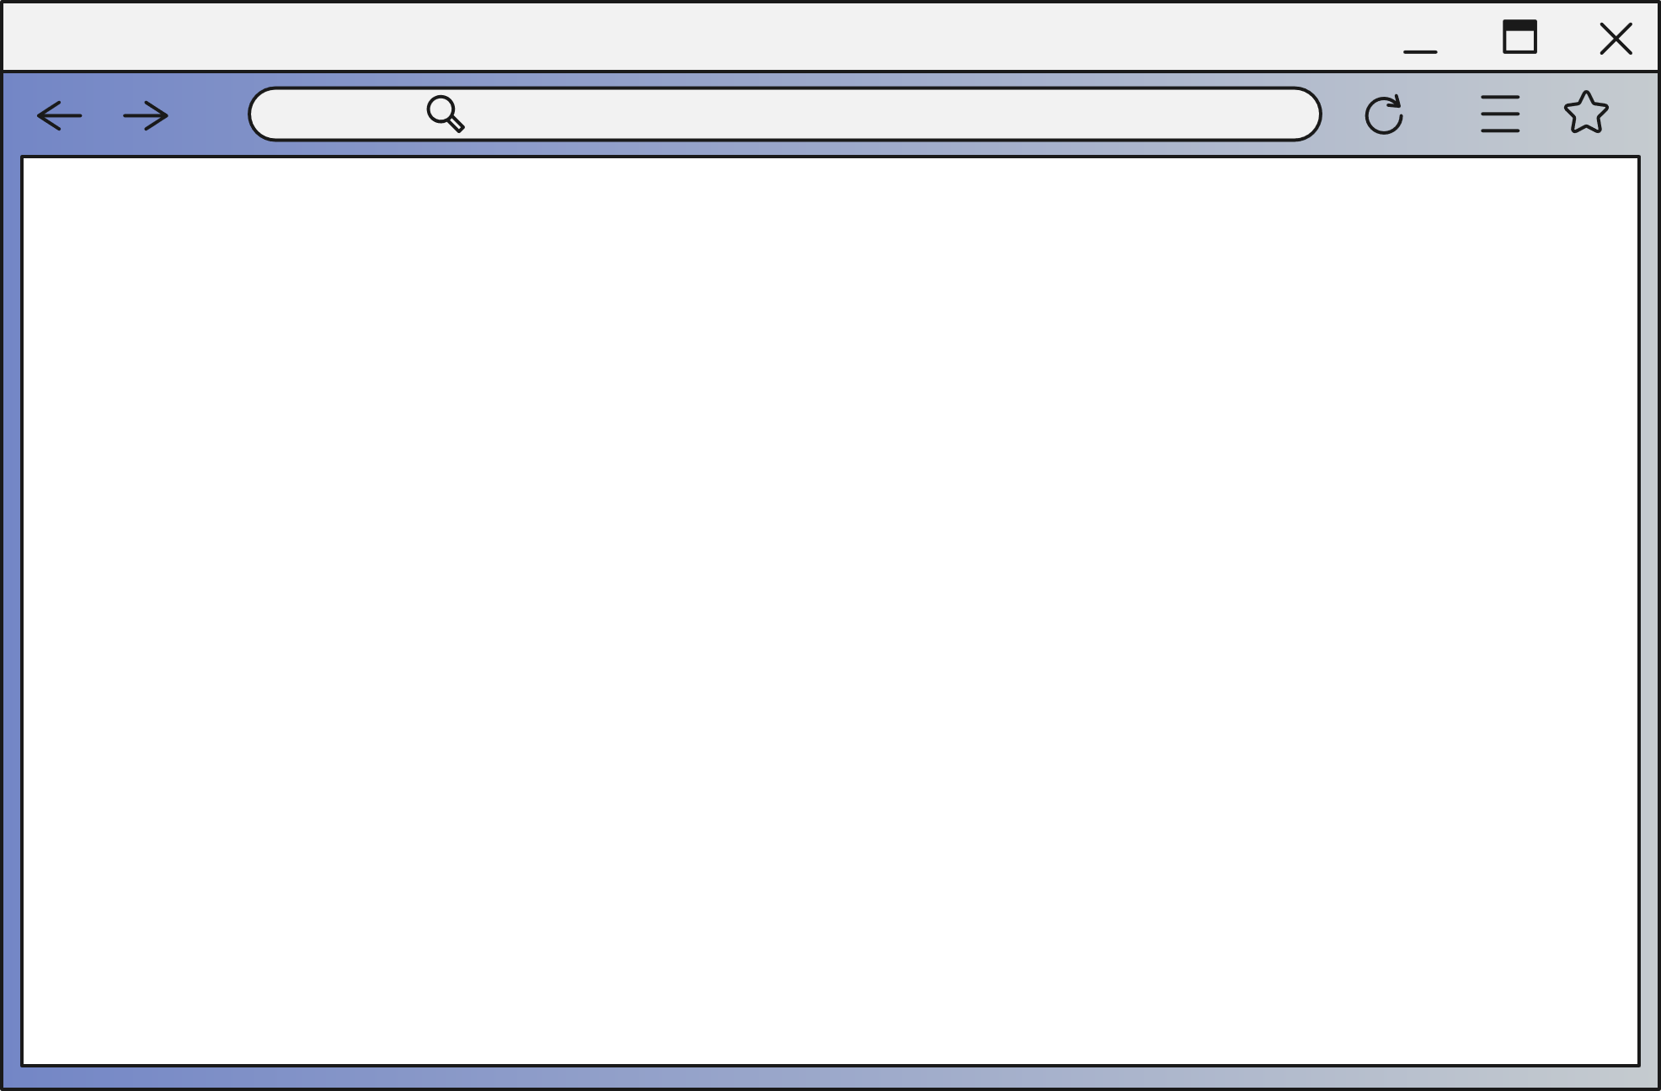
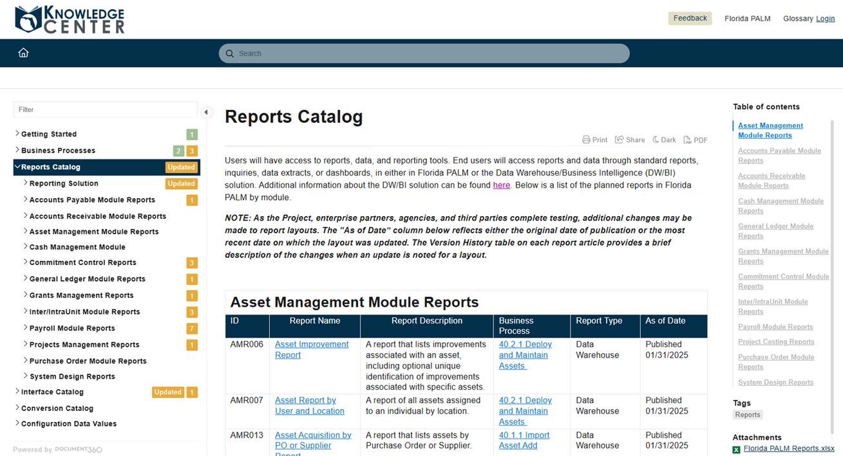
DW/BI Consumers will be able to:
  Run a report,
  Filter/prompt using parameters.
  Schedule a report,
  Set up email alerts,
  Print or download a report,
  Choose an output type (.xls, .pdf., .csv),
  Distribute/attach reports, and
  Add reports as favorites.
DW/BI Authors will also be able to:
  Create a query,
  Modify a query (drag and drop),
  Share a query (privately), and
  Publish a query (DFS only).
Your role assignment dictates the level of access to specific reports or reporting functionality. Each user role has a role article within the Knowledge Center that describes the capabilities of the role, including reporting, and which business processes they support.
End users can schedule reports to be delivered automatically via various channels, including via web browser or email. Email alerts can be set by users who can choose to download or print reports and distribute them via email or other methods. End users can also ‘favorite’ reports for easier access. Report prompts are available to target information specific to agency needs.
Knowledge Center: Reports Catalog
In the Knowledge Center: Reports Catalog you will find a list of planned reports by Module. The Knowledge Center is being updated as work is completed, and information becomes available.
  Reports are organized by Business Process Modules. The prefix for each report will corresponds to the Module where the data for that report is stored.
  Detailed information and samples are available for most reports, showing the fields included in the report.
  Also included are the associated Business Process Model and the roles expected to use the report.
  Yellow boxes indicate an update, and green boxes show additions to the catalog.
A directory of reports can be found on the landing page of the Reports Catalog, which includes the ID number, name, short description, Business Process Model, report type, and date of the most recent update.
5

Slide 6


Each report in the catalog has a Report Detail page. These pages are being updated on a regular basis so check back frequently on the reports that you are interested in using. The report title, number, a brief description, and the report location (DW) or report navigation (Florida PALM) are at the top of the page. Many reports have a sample layout available.
Each report has a table with the column names (DW/BI) or data fields (Florida PALM). In some cases, the report from the DW/BI may use column descriptions other than the underlying field name, when there are calculations, or it is formatted according to a law or rule.
The report detail pages may also include a suggested frequency for running the report, the Business Process Model associated with that report, the user role associated with the report, report prompts or selection criteria that can be used to filter the report, and a version history.
Searching the Knowledge Center
The Knowledge Center has search capability, including an Advanced Search feature. Type your search into the box at the top, left corner of the Knowledge Center or type CTRL + K. A list of options will dropdown and you can choose one or click on ‘More article filters’ at the bottom, right of the list. Narrow your returns to a specific subject by using the filters on the left-hand side of the page. Scroll down for more filters.
Preparing for UAT and Go-Live
01.
02.
03.
04.
Understand the Data You Use
Document Key Report Details
Learn the New Terms & Data Flow
Prepare to Test Reports During UAT
6

Slide 7
Transitioning to Florida PALM is a marathon, not a sprint. Proper preparation now will ensure you feel confident and capable during UAT and at Go-Live. This handout outlines key steps to help you get ready by focusing on the reports and data you use every day.
  Step 1: Understand the Data You Use
  Take time to review how you access the data you need to perform your job tasks. Focus especially on reports tied to processes and subprocesses relevant to your role.
  Identify the reports you currently run using RDS, FLAIR@DFS, or directly from IW. In 2024, each division/office identified all current reports as part of an RW Task. Reach out to the CCN to request a copy of your reports, if needed.
  Think through the calendar year and capture recurring reports used for:
    Legislative reporting,
    Asset tracking,
  Think beyond reports run in FLAIR, as systems that interact with FLAIR will be remediated to interact with Florida PALM (or retired), and you will want to ensure you can still capture the data you need.
    Budget management, and
    Any other essential business functions
  Step 2: Document Key Report Details
  For each report you use, document the following information:
  Purpose: Why do you run this report?
  Usage: How is the data used?
  Important Elements: What specific data elements are most important?
Locate comparable reports in Florida PALM or the DW/BI. If you cannot find a replacement report, notify your CCN. Together, you’ll work on identifying solutions to ensure business continuity.
Step 3: Learn the New Terminology and Data Flow
Understanding how data is moves through the Florida PALM Modules and to the DW/BI and Enterprise/ABS is essential to ensuring you can locate the reports you need. Also, understanding changing terminology will ensure that reports reflect the data you’re seeking.
  Study terminology changes and changes to the Chart of Accounts on the DFS Florida PALM Stakeholder SharePoint and the Florida PALM Knowledge Center. The Business Process Models may be especially helpful to understanding data flow and terminology.
  Review Florida PALM Module Interactions to learn where data is stored. Remember that timing will be critical when accessing specific data. For example, if you are seeking to pull data from the prior month, you will need to use a DW/BI report. On the other hand, if a transaction has a coding or budget issue and the user wants more details, that data will be found on a report directly in Florida PALM.
7

Slide 8


  Step 4: Prepare to Test Reports During UAT
Compile a list of reports to run during UAT so that you can evaluate the data on those reports to be sure it will meet your needs. Encourage other end users in your division/office to follow the same steps for each report they rely on.
If you find that you aren’t able to locate a Florida PALM or DW/BI Report that will provide the data you need, document the key details for that report. Reports are continually being updated in the Knowledge Center, so check back frequently. If necessary, a DW/BI Author may be needed to create the report for you. During UAT, you will be able to collaborate with SMEs and the CCN to ensure all your reporting needs are met.
Testing Timeline
  Testing: DW/BI system testing will begin in August during UAT.
  Data Dictionary: This will be created/finalized after the Data Warehouse is complete, with expected release during UAT.
Additional Resources
Knowledge Center:
Data Warehouse Demo
  Data Warehouse / Business Intelligence demo: (11 mins)
  Reporting & Data Warehouse Update at 2:35:30: (40 mins)
  Change Catalog
  Reports Catalog
  Business Processes
  Module Interactions
  Chart of Accounts Design
  Reporting Solution
  User Roles
  Accounting and Budget Events Inventory
Interface Catalog
The Knowledge Center: Interface Catalog contains the related interfaces for each Module. The file layouts in this catalog include the business definitions for each data field and the data values configured in the system for that field (if applicable).
Conversion Catalog
The Knowledge Center: Conversion Catalog contains details related to transforming legacy data and loading it to Florida PALM. Florida PALM will use legacy data from FLAIR and Agency Business Systems to populate opening balances in the General Ledger and the data needed to support operations.
Configuration Data Values
The Knowledge Center: Configuration Data Values page contains information related to the settings or parameters that determine the behavior or functionality of the Florida PALM system. Configuration values can control various aspects of the system's operation. These values vary depending on the specific Modules and components being used.
8

