Slide 1




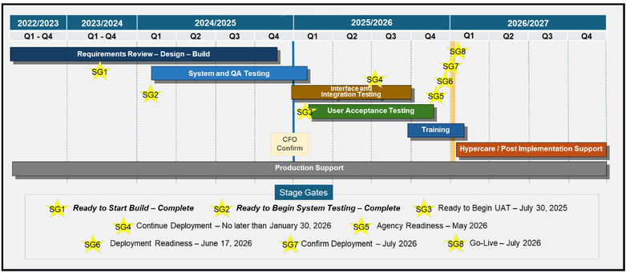

Florida PALM Updates
Project Timeline
What has changed?
The go-live date for the Financials Wave, Payroll Wave, and Data Warehouse is moving from January 2026 to July 2026. Additionally, a stage gate has been added that allows the Executive Steering Committee (ESC) to vote to delay implementation to January 2027, if it determines the State is not prepared to go-live in July 2026.
What other dates have changed?
Interface testing for DFS will start in June 2025 and is extending by one month. UAT starts in August 2025 and is extending by two months. RW tasks will be updated to align with the new timeline and mock conversion timelines will be shifted. Cutover shifts from Calendar Year to Fiscal Year, with Florida PALM going live once Central FLAIR closing has occurred. A mid-year Payroll conversion will be needed.
Why did this happen?
Recent delays in the Build Phase have impacted critical milestones, including the timeline for UAT. Recognizing the need for a well-built and thoroughly tested system, the Project team and DFS leadership proposed a revised schedule to the ESC. Additionally, feedback from agencies has emphasized the need for more time to ensure readiness for go-live.
What does this mean?
This proposed adjustment is a positive step. It provides Florida agencies and DFS the additional time needed to refine our efforts, address challenges, and conduct comprehensive UAT, ensuring we move forward with confidence in the project's success. From the beginning, our goal has been to build on lessons learned from the CMS Wave, strengthen confidence in the system, and remain transparent about project impacts. This change means we can be even more confident in a successful go-live for Florida PALM.
What should I do to prepare?
Don’t let off the gas! Your contributions to preparing for Florida PALM are invaluable. Your CCN and Division/Office POC are here to help. Continue to visit the DFS Florida PALM Stakeholder and the Florida PALM Knowledge Center sites and reach out to your Division/Office POC or CCN Change Coordinator with any questions or post them on our Question Board.
February 2025

