Slide 1



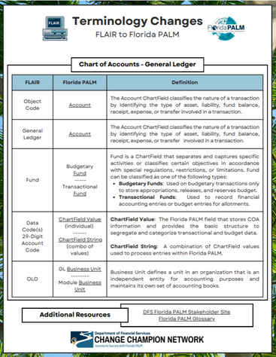
Florida PALM
UPDATES
Your CCN and the Project are working hard for you! Below is a sneak peek into five tools and trainings that are being developed to help you successfully navigate User Acceptance Testing (UAT) and the transition to Florida PALM.
Micro-Trainings / Lunch & Learns
A series of Micro-Trainings and Lunch & Learns covering the Chart of Accounts, Navigating the Knowledge Center, Running Reports in Florida PALM, Design Session Overviews (and more) are being developed for deployment. Have a topic you’re interested in? Let us know at DFS.CCN4U@myfloridacfo.com.
UAT Prerequisites
UAT Prerequisite Training will help you begin UAT with confidence. The trainings will be offered on the People First LMS, so they can be easily referenced. Topics include: accessing the system, reporting testing results, where to ask for help, and more.
UAT Handbook
The UAT Handbook will be your go-to guide during UAT. The handbook will have guidance for end-users, the answers to frequently asked questions (FAQs), a glossary of common terms, and more.
Handouts & Job Aids
If you haven’t been to the Resources Tab on our DFS Florida PALM Stakeholder site recently, go now! This site is updated regularly with handouts, fliers, job aids, and games that are designed to assist you in preparing for go-live.
Project Training
The Florida PALM Project is developing readiness and training materials, including an end user manual, to help you as you transition to Florida PALM. These resources will be posted in the Florida PALM Knowledge Center as they become available.
Keep an eye on the Sponsor Snapshot and our DFS Florida PALM Stakeholder SharePoint for more information.
April 2025

