Slide 1







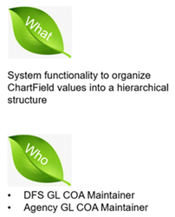

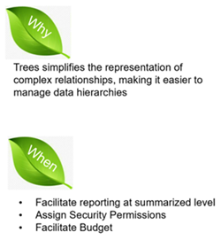

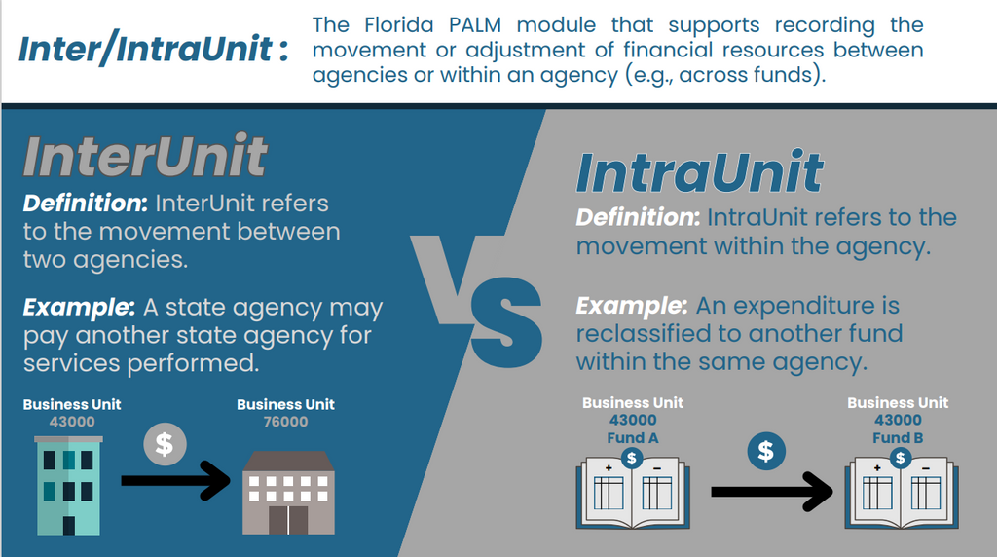

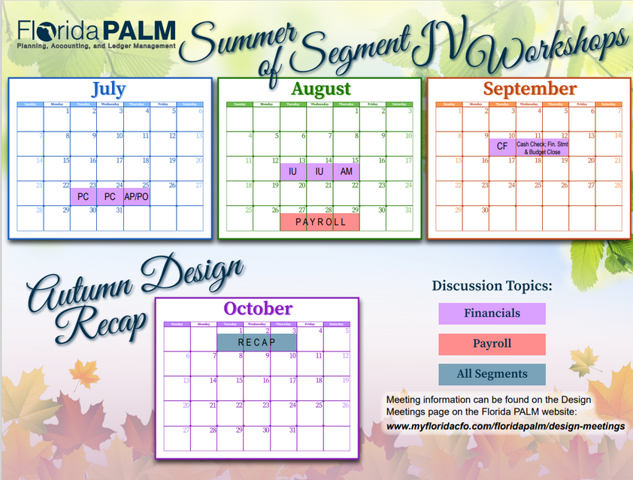
5
June 2024
Florida PALM Updates
Agency Readiness Reporting Page Live
WHAT’S
NEW?
Agency stakeholders now have direct access to our agency’s readiness dashboard!
Wanna see how DFS is doing?
Florida PALM Trees are Growing
Vocabulary Corner
New PALMCasts Available
Episode #14 - Organizational Change Management: Desire
  Guests: Vincent Cicco and Alise Fields
Episode #16 - Organizational Change Management: Engaging Managers of End Users
  Guests: Daniella Cross-Wilkins of FDOT, Felicia Hall, and Nicole Jacobik
Want to listen?
Summer of Segment IV Workshops
COMING SOON
Click here for all Design Workshop information

