Slide 1
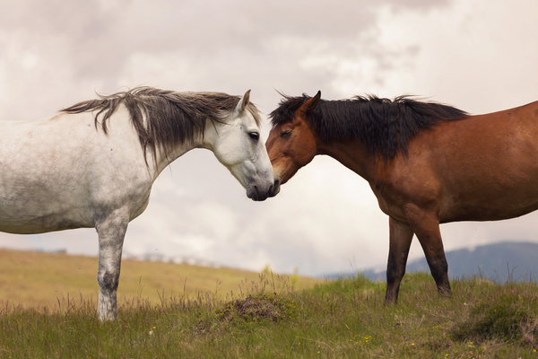




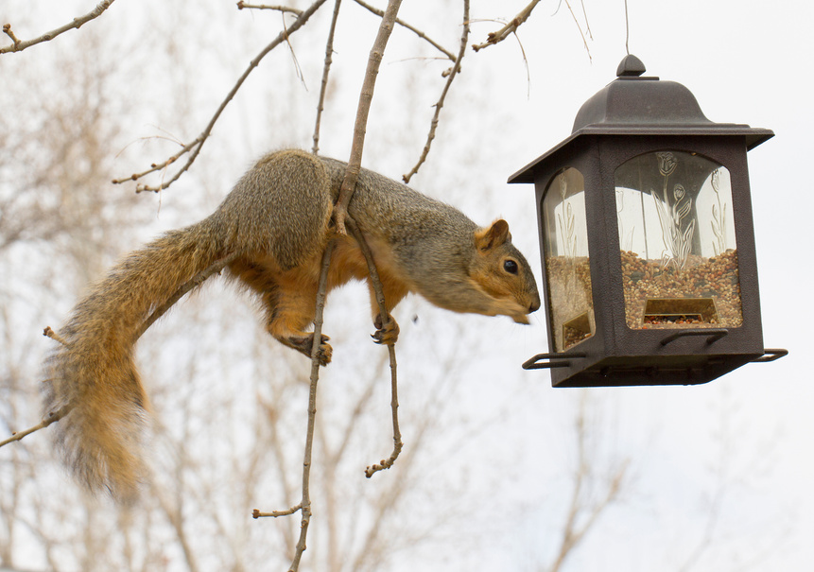

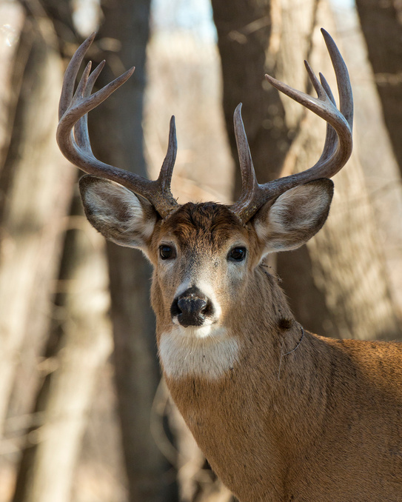
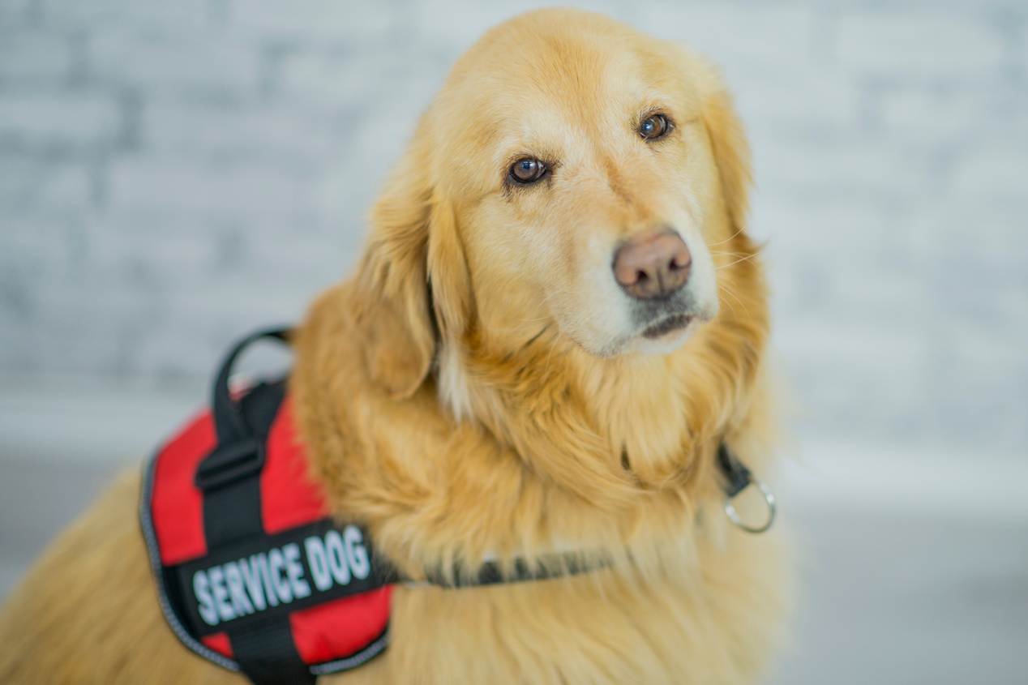
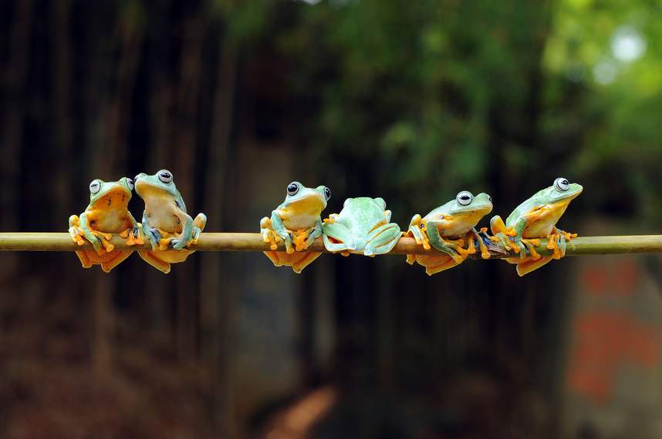
ACCEPTANCE
HONOR
The people around me approve of what I do and who I am.
It’s important that my personal values are reflected in how I work.
CURIOSITY
ORDER
I have plenty of things to investigate and to think about.
There are enough rules and policies for a stable environment.
AUTONOMY
MASTERY
I am independent of others with my own work and responsibilities.
My work challenges my competence but is still within my abilities.
STATUS
EMPOWERMENT
My position is good, and recognized by the people who work with me.
There’s enough room for me to influence what happens around me.
PURPOSE
RELATEDNESS
My work has meaning and a positive impact in the world.
I have good social contacts with the people in and around my work.

Slide 2
Honor is about loyalty to a group and integrity of one’s behaviors according to your moral code or values. Other words might be:
Acceptance is about the need for self-esteem and having a positive self-image. It’s about being accepted for who you are. Other words might be:
  Character
  Principles
  Morality
  Virtue
  Affirmation
  Self-worth
  Validation
  Approval
Order is about a need for certainty and stability in our environment. Other words might be:
Curiosity is about the joy of learning and understanding how things work. Other words might be:
  Structure
  Security
  Organization
  Constancy
  Procedural
  Permanence
  Invention
  Exploration
  Knowledge
  Discovery
  Inquisitiveness
  Learning
Mastery is about growing your level of competence and being challenged in your work. Other words might be:
Autonomy is about being able to be independent and self-directed in your work. Other words might be:
  Challenge
  Aptitude
  Ability
  Proficiency
  Skill
  Expertise
  Self-sufficiency
  Self-determination
  Prerogative
  Latitude
  Freedom
  Choice
Empowerment is about leadership and the ability to make changes in the world. Other words might be:
Status is about recognition, privilege, and rewards, often in the form of titles, badges, awards, and increased social standing. Other words might be:
  Influence
  Power
  Coaching
  Potential
  Control
  Leverage
  Position
  Prestige
  Stature
  Reputation
Relatedness is about feeling like you belong and enjoying interactions with others. Other words might be:
Purpose is about having a connection to something that is bigger than yourself or something that has greater meaning. Other words might be:
  Belonging
  Affinity
  Association
  Inclusion
  Rapport
  Friendship
  Calling
  Aspiration
  Duty
  Lifework

