Slide 1









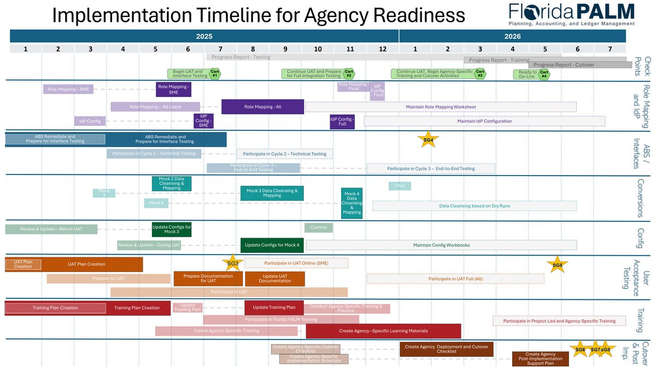



















Florida PALM
SPONSOR
SNAPSHOT
June 2025
Division Shout-Outs:
Play games that will help prepare you for end user UAT in August 2025!
DFS Risk/Issues Managers — Brittany Pittman, Cathy Sauls, Nancy Anderson, Don Hurst, Mireia Vidal, and Asif Sahaf — A heartfelt thank you for your continued dedication and partnership in supporting each division/office with the management of Florida PALM Agency and Project Risks and Issues! Your collaborative spirit and commitment to an engaging, flexible, and proactive process have made a lasting impact on how we identify and address risks. The strength of your teamwork lies not only in your expertise, but also in the way you lift one another up — drawing from both past experiences and new insights — and generously sharing those lessons with stakeholders across the board. Thank you for helping to build a strong foundation for Florida PALM’s success through your thoughtful, consistent, and strategic efforts!
Division of Accounting and Auditing, Bureau of Auditing — Kim Holland, Don Hurst, Jennifer Patnode, Birgit Campa, Andrea Brazell-Bui, Letisha Williams, Erica Uzzell, Justin Jones, Komol Patel, Siri Duddu, Candace Allen, Morgan Vargas, Cynthia Washington, John Davis, Suzette Harris, Obenson Prudent, Meshanda Hobley, Jenna Lively, Tyesin Payne, and Anna Thompson — Thank you for your enthusiasm and contribution in identifying Enterprise UAT test scenarios to ensure the new accounting system aligns with our needs and reinforces our internal controls. Your hard work in this critical phase of the testing process is truly valued!
What’s Due in June:
Heads up POCs & SMEs! The CCN may call on you to help with the following:
  Task 571: Complete Data Cleansing Based on Mock Conversion 2 - Due 6/20 - Evaluating and managing agency data based on Mock 2 conversion activities.
  Task 573-A: Complete and Submit End User Role Mapping Worksheet for UAT - Due 6/20 - Assigning roles to identified Subject Matter Experts in preparation for August manual online User Acceptance Testing.
  Task 657: Submit Updated Configuration Workbooks - Due 6/20 - Updating and confirming configuration values in preparation for User Acceptance Testing.
  Task 659: Update Conversion Field Mapping - Due 6/20 - Mapping FLAIR codes (ORG, OCA, Grant ID, and Location Code) to Florida PALM values for Mock 3 Conversion.
CROSSWORD PUZZLES
A complete list of Tasks, including those launching on a future date can be found on the Florida PALM website, here.
The Project updated the Implementation Timeline, including all dates related to Configuration, Readiness Workplan tasks, Stage Gates, progress reporting, and more!
MATCHING
MULTIPLE CHOICE
To view and print this Implementation Timeline
Prepare for
User Acceptance Testing:
Faded Colors = Old ranges
Bold Colors = New ranges
- - - - = Agency participation
June Lunch & Learn
WHEEL OF FORTUNE
The following Florida PALM related trainings are being offered by the Office of Florida Financial Education (OFFE) in the month of June:
Grab your lunch, your notebook, and your friends for our monthly Lunch & Learn Session that is designed to provide insight into key areas of Florida PALM prior to Go-Live. P.s. This is a wonderful opportunity to ask questions based on the predetermined subject matter!
Click each sun to register in People First.
Topic
Chart of Accounts, Part 2
WORD SCRAMBLES
FLAIR to Florida PALM: The Chart of Accounts (COA)
Florida PALM Training Highlights - Navigation
with an agency-unique perspective
Tuesday, June 3, 12 pm-1 pm
June 5, 9 AM - 1 PM
June 10, 9 AM - 1 PM
June 17, 1 PM - 5 PM
June 12
9 AM - 11 AM
In-person - Larson Building, B33
Online - GoTo Webinar
Reach out to your POC and/or SME for more information.
WORD
SEARCHES
LET'S FLOAT TO FLORIDA PALM TOGETHER!
DFS Florida PALM Stakeholder SharePoint | DFS.CCN4U@MyFloridaCFO.com

