Slide 1










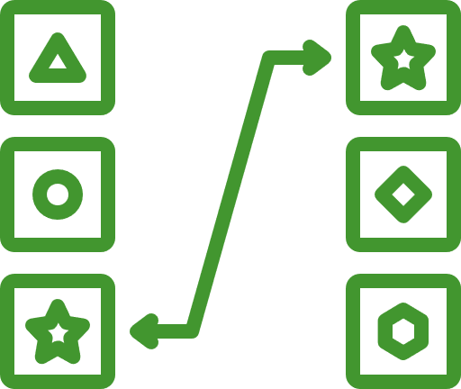











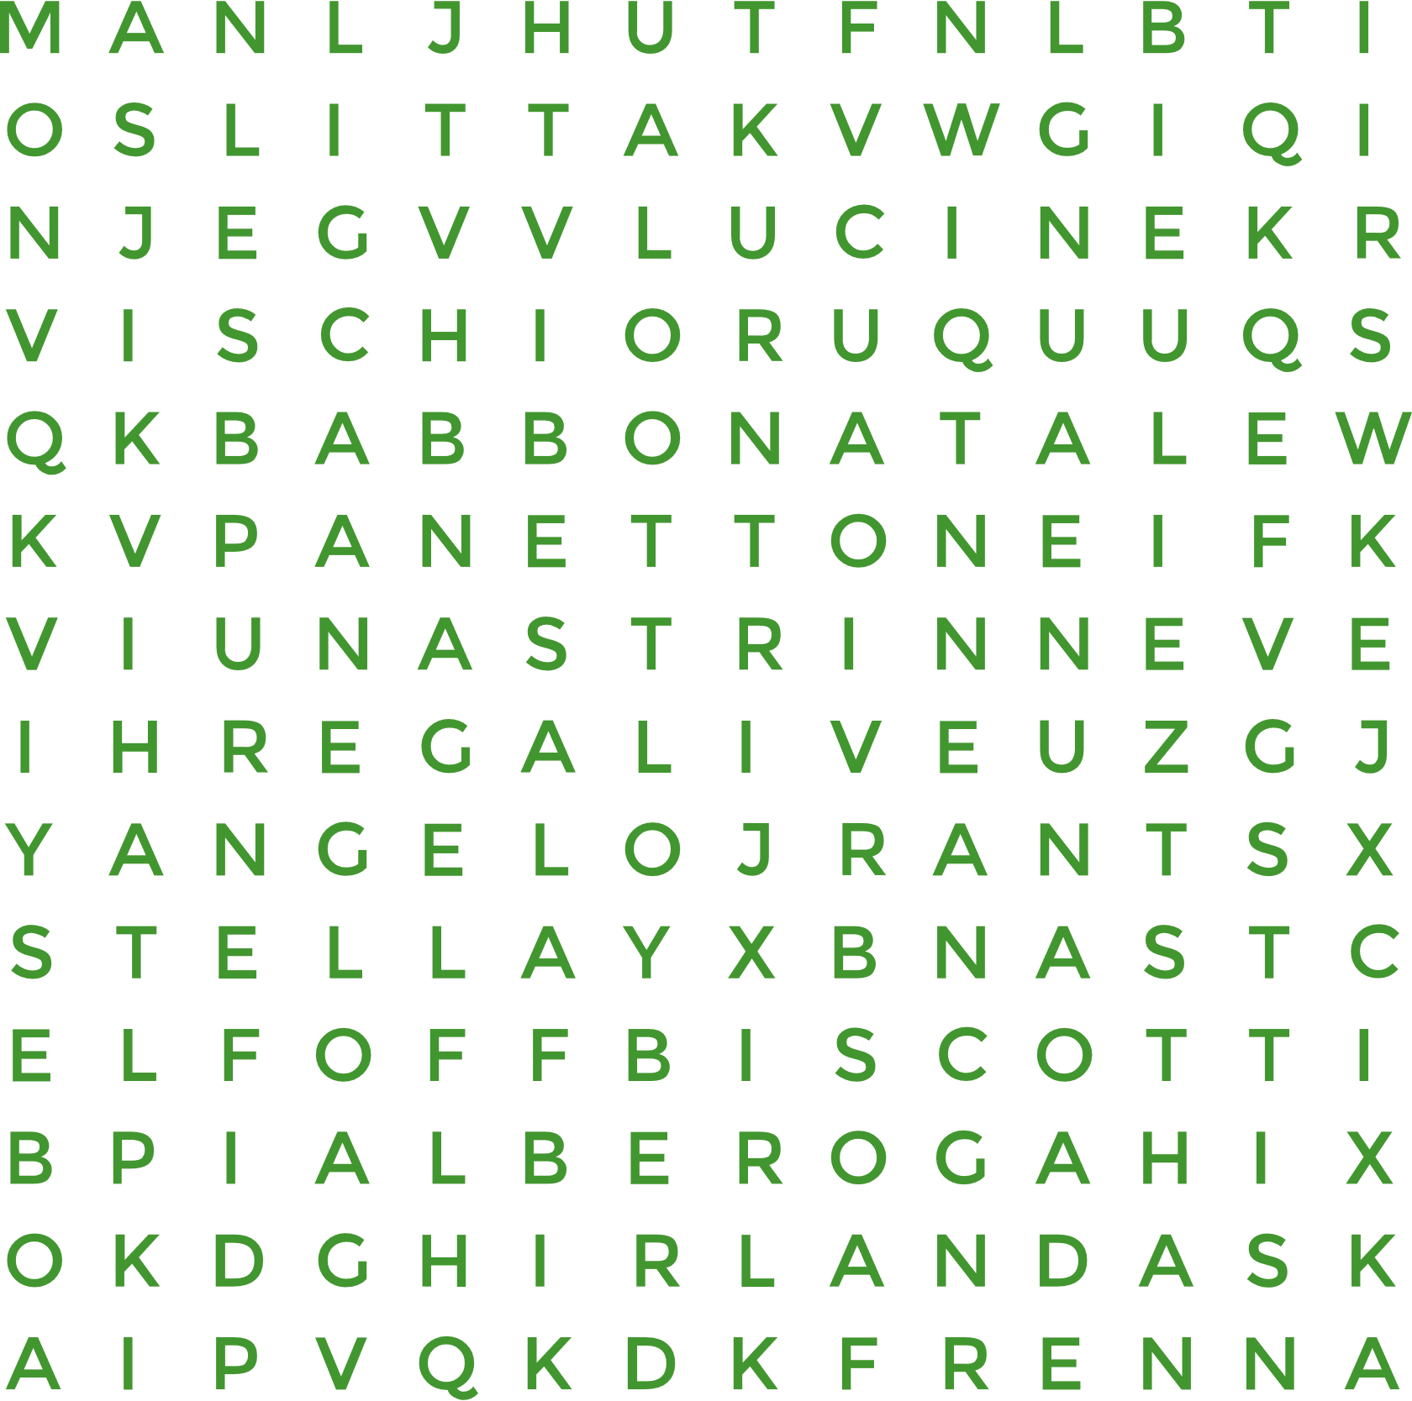



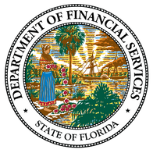


Florida PALM
SPONSOR
SNAPSHOT
April 2025
Division Shout-Outs:
Play games that will help prepare you for end user UAT in August 2025!
Treasury - Welcome back, Sarah Pons, CCN Treasury Liaison! 🎉 Your return from maternity leave has been nothing short of impressive — you’ve hit the ground running, all while sporting that beautiful "New Momma Glow"! Thank you for your continued engagement, dedication, and support to the CCN and DFS. We’re grateful to have you back! 💙
OIT ABS Remediation Team - A huge ‘Thank You’ to the developers, analysts, and managers —your dedication, time, talent, and support in making the “coding magic” happen across 21+ systems interfacing with Florida PALM is truly commendable. Each of you sets an example for sister agencies, proving that remediation can be achieved on this implementation journey. Your hard work and commitment do not go unnoticed — thank you for making this possible!
Workers’ Compensation - Your active involvement in Monthly Conversion Data Monitoring is inspiring! The attention to detail you’re providing will be an incredible benefit at go live. Thank you for your attention to detail, open communication, and willingness to do whatever it takes to get the job done for all activities. Keep up the great work!
DFS CCN - A special shoutout to Kim Jacobs, CCN Training Liaison, for your boundless enthusiasm and your tireless efforts to make the transition to Florida PALM run smoothly! And to Julia Collins-Okane, A&A Liaison Backup, for always being willing to lend your expertise to help us through this transition. We’re so lucky to have both of you!
What’s Due in April:
Heads up POCs & SMEs! The CCN may call on you to help with the following:
CROSSWORD PUZZLES
  Task 536-C: Create Agency Specific User Acceptance Testing (UAT) Plan - Due 4/11 - A tool that outlines why, what, and how business processes will be performed - reporting issues before Florida PALM goes live.
  Task 560: Submit Change Analysis Tool - Due 4/11 - Reviewing, updating, and/or confirming identified change impacts to business processes.
  Task 590: Manage Agency-Specific Implementation Schedule, Risks, and Issues - Due 4/30 - Managing your agency's project activities including iterative updates to agency-specific project schedule and managing agency-unique risks and issues.
A complete list of Tasks, including those launching on a future date can be found on the Florida PALM website, here.
Hey, my
Peeps!
Training Highlight:
Led by your amazing CCN OCM, Amy Topol,
in this training we will:
MATCHING
Change Management for Supervisors
  Contrast our reactions to change,
  Discuss the 5 Tenets of Change,
  Review the ADKAR Methodology,
  Learn the 5 roles of a manager during change, and
  Put it all into practice.
Change can be stressful especially when you add Florida PALM to the mix. You’re expected to navigate the change, lead your team, and keep the day-to-day operations moving forward. Knowing the process for change management and the part you play makes your role and goals much clearer.
MULTIPLE CHOICE
Date & Time: TBD
Keep an eye out for more information!
Prepare for User Acceptance Testing:
WHEEL OF FORTUNE
Attention
POCs & SMEs!
The following Florida PALM related trainings are being offered by the Office of Florida Financial Education (OFFE) in the month of April:
Mark your calendars:
Click each egg to register in People First.
Our next DFS Florida PALM POC/SME Monthly Meeting is scheduled for Tuesday, April 29
Statewide - Contract and Grant Monitoring
Florida PALM Training Highlights - Navigation
WORD SCRAMBLES
Micro-Training Topic:
FLAIR to Florida PALM: The Chart of Accounts
Chart of Accounts
Design Session Breakdown
April 9
9 AM - 4:30 PM
April 8
9 AM - 1 PM
April 10 1 - 3 PM
April 16 9 - 11 AM
April 24 9 - 11 AM
April 23
1 - 5 PM
WORD
SEARCHES
LET'S HOP TO FLORIDA PALM TOGETHER!
DFS Florida PALM Stakeholder SharePoint | DFS.CCN4U@MyFloridaCFO.com

