Slide 1








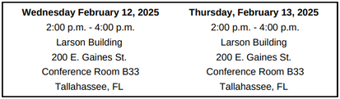






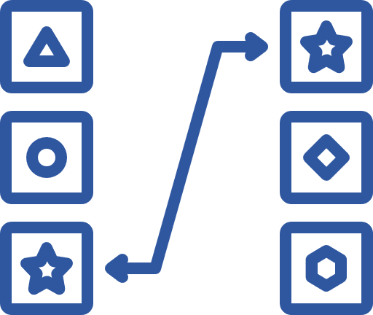



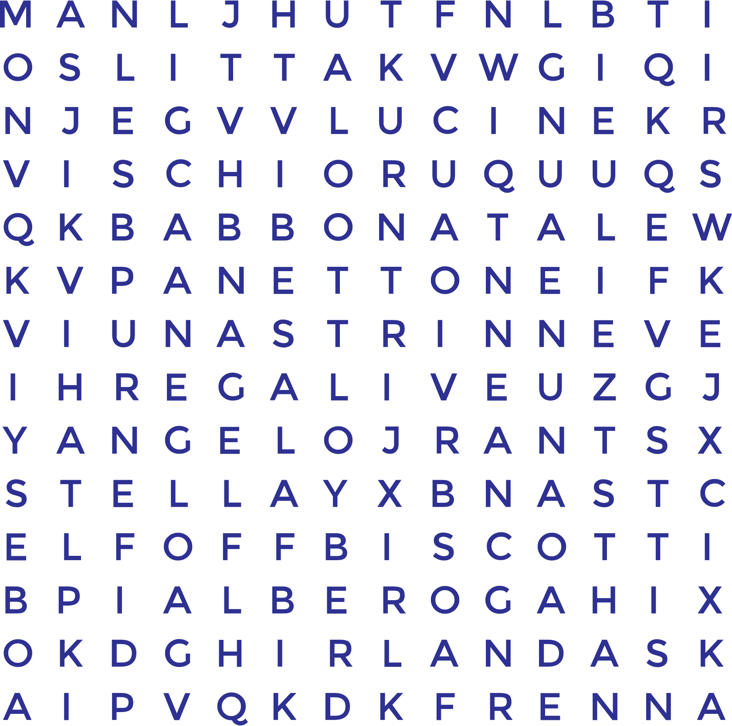


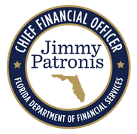

Florida PALM
SPONSOR
SNAPSHOT
February 2025
Division Shout-Outs:
CCN Risk and Issues Team - This amazing team of pioneers has designed a repeatable and efficient process, setting a new standard for documenting agency risks and issues! Your innovation is making waves, inspiring sister agencies to adopt and replicate, and helping make a lasting impact!
OFB Reconciliation and Reporting Unit - The dedication and effort you put into developing a creative and insightful analysis of the agency the Chart of Accounts (COA) crosswalk and data conversion monitoring process has not gone unnoticed! Your efforts will soon empower divisions/offices to improve operational efficiency, ensuring data remains clean and assisting in learning the new values.
DFS Senior Leadership - Your dedication, allocation of resources, and consistent commitment have been instrumental to our continued project implementation success! Thank you for your unwavering support with all CCN initiatives.
OIT ABS Analysts and Developers - Your coordination, teamwork, and meticulous efforts in remediating countless Florida PALM-impacted DFS agency business systems has been incredible! Your hard work and precision continue to drive progress forward!
What’s Due in February:
Training Highlight:
Heads up SMEs & POCs! The CCN may call on you to help with the following:
Project Management for Non-Project Managers
  Task 567-P: Share, Review, and Update Configuration Workbooks (All-SpeedKey) - Due 2/14 - Reviewing and updating the SpeedKey Configuration Workbook.
  Task 567-Q: Share, Review, and Update Configuration Workbooks (GL - Default Interest Apportionment) - Due 2/21 - Reviewing and updating General Ledger module configuration values.
  Task 570: Manage Agency-specific Implementation Schedule, Risks and Issues - Due 2/28- Managing your agency's project activities including iterative updates to agency-specific project schedule and managing agency-unique risks and issues.
  Task 582: Share Florida PALM Updates - Due 2/7 - Sharing Florida PALM updates and agency progress with key agency stakeholders.
  Task 584: Update Authorized Smartsheet Users - Due 2/7 - Reviewing and updating authorized agency Smartsheet users.
Come join Amy Topol, your CCN’s Organizational Change Management Liaison, as she breaks down the fundamental concepts of project management and demonstrates how they apply in real-world scenarios like the Florida PALM Project!
or
to register
A complete list of Tasks, including those launching on a future date can be found on the Florida PALM website, here.
Training includes: understanding what contributes to project success and failure, defining project objectives, preparing a contingency plan, and much more!
What’s Happening
(Behind the Scenes)
Prepare for User Acceptance Testing:
The Office of Finance and Budget is working to create a FLAIR to Florida PALM Chart of Accounts crosswalk and a data conversion monitoring plan (including a checklist) that will be used to keep division data clean until go-live!
The following webinars are being offered by the Office of Florida Financial Education (OFFE) in the month of February:
more info
coming soon
Florida PALM Cash Management System
Florida PALM Navigation
FLAIR to Florida PALM: The Transformation of the Chart of Accounts
February 5, 9am-12pm
February 11, 1pm-3pm
February 20, 9am-1PM
If you are too excited to wait for more information, email: Sheila Cole, your CCN Business Liaison!
February 26, 9am-11am
Click each (love) note to register in People First.
Play games that will help prepare you for end user uat in june 2025!
CROSSWORD PUZZLES
MATCHING
MULTIPLE CHOICE
WHEEL OF FORTUNE
WORD SCRAMBLES
WORD
SEARCHES
LET'S CRUISE TO FLORIDA PALM TOGETHER!
DFS Florida PALM Stakeholder SharePoint | DFS.CCN4U@MyFloridaCFO.com

