Slide 1





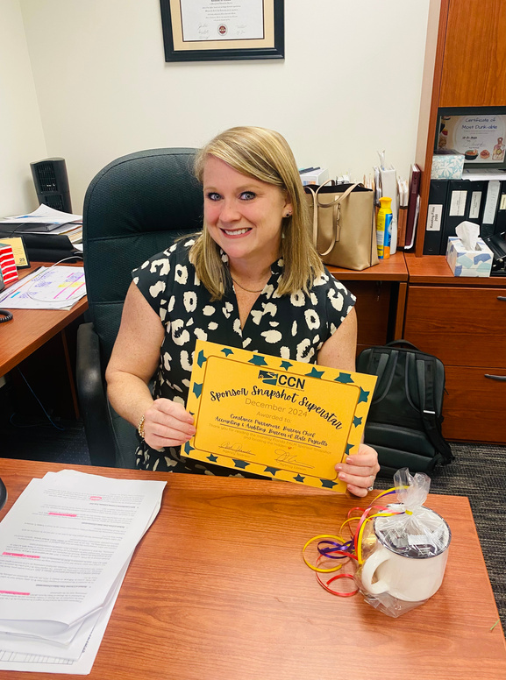
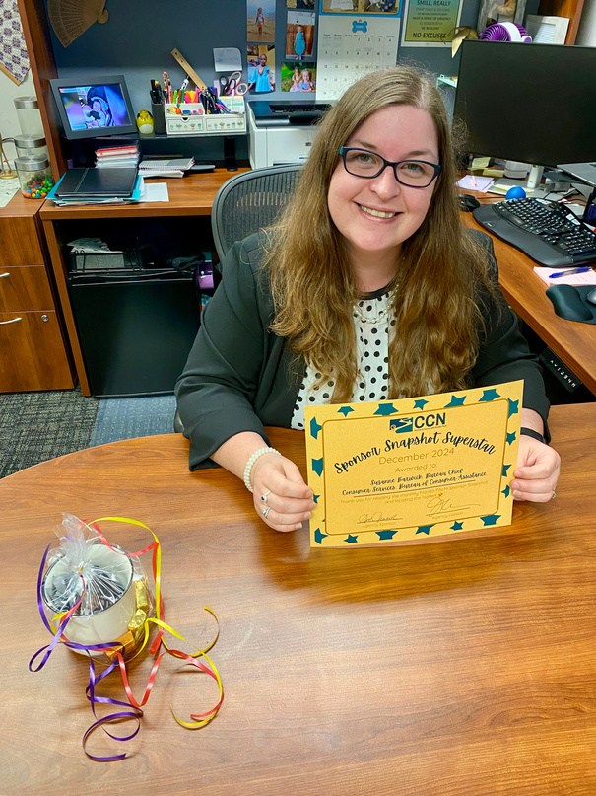





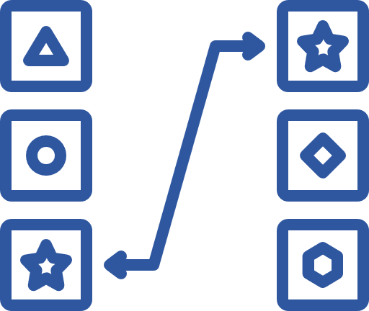







Florida PALM
SPONSOR
SNAPSHOT
January 2025
Division Shout-Outs:
Administration - Property Team - Your data conversion success on the DFS Property file was phenomenal! There were over 15,000 records converted with only 9 minor edits needed. We see you doing great things!!!
A&A - FACTS Team - Your team, in collaboration with OFB and OPCS is working like a well-oiled machine to address all contract conversions. Teamwork is making our Florida PALM dream work!
OFB, DRM, DWC, and A&A - Vendor Team - You guys are working together to script 1,529 records to the Vendor File for conversion inclusion. WOW! That’s impressive work and collaboration!
Sponsor
Snapshot
Superstars
Congratulations to the first Bureau Chiefs to read the December Sponsor Snapshot and locate the on our DFS Stakeholder site!!!
Constance Parramore, Chief
Bureau of State Payrolls
Suzanne Barwick, Chief
Bureau of Consumer Assistance
What’s Due in January:
Heads up SMEs & POCs! The CCN may call on you to help with the following:
  Task 536-C: Create Agency Specific User Acceptance Testing Plan - Due 1/31 - Confirms business processes to be tested and identifies UAT success criteria.
  Task 558: Update Agency Business System Documentation - Due 1/10 - Reviews and updates agency business system documentation based on your final selection of interfaces in preparation for Cycle 2 – Technical Interface Testing.
  Task 560: Submit Change Analysis Tool - Due 1/31 - Documents your agency's change impacts to your people, processes, technology, and data at implementation.
  Task 564: Update Future Florida PALM End Users - Due 1/10 - Updates the list of all end users who will need access to Florida PALM at implementation.
  Task 567-J-K, P: Share, Review, and Update Configuration Workbooks - Due 1/17 - Reviews and updates the Distribution Code (AR) Configuration Workbook, Consolidated Revolving Account (CM) Configuration Workbook, and the SpeedKey Configuration Workbook.
  Task 569: Submit Bimonthly Agency Readiness Status Report - Due 1/10 - Documents activities and ongoing work within the agency to prepare systems and impacted employees for Florida PALM deployment.
  Task 658-A: Submit Data Field Mapping (Org) - Due 1/31 - Reviews and updates agency mapping of FLAIR Org values to Florida PALM Organization values.
  Task 658-B: Submit Data Field Mapping (OCA) - Due 1/31 - Reviews and updates agency mapping of FLAIR OCA values to Florida PALM values.
A complete list of Tasks, including those launching on a future date can be found on the Florida PALM website, here.
Play games that will help prepare you for end user uat in june 2025!
CROSSWORD PUZZLES
MATCHING
MULTIPLE CHOICE
WHEEL OF FORTUNE
WORD SCRAMBLES
WORD
SEARCHES
LET'S CRUISE TO FLORIDA PALM TOGETHER!
DFS Florida PALM Stakeholder SharePoint | DFS.CCN4U@MyFloridaCFO.com

