Slide 1
Tips & Tricks for Monitoring Deposits

Slide 2
Tips & Tricks for Monitoring Deposits
Bank File received from banks
Bank Records loaded to Florida PALM/FLAIR
Deposit Reports created in Florida PALM

Slide 3
Tips & Tricks for Monitoring Deposits
6:00AM T-Sat
6:00AM T-Sat
6:00AM T-Sat
4:30AM-8:00AM T-Sat
6:00AM T-Sat
6:00AM T-Sat
6:10AM T-Sat
6:15AM T-Sat
11:00AM M-FRI
CMI003
(BOA)
CMI010
(BOA)
CMI015
(WF)
CMI003
ARI003
(BOA)
CMI017
(NIC)
ARI033
(NIC)
ARI022
(WF)
ARI007
(DOR)
CMI003
(WF, JPM)
Cash Management & Accounts Receivable Interface Flow
ARI003 | Inbound ACH NOC and Return Deposit Data
ARI007 | Inbound Deposit Data
ARI022 | Inbound Returned Item Check Data
ARI033 | Inbound ACH NOC and Return Deposit Data
ARI014 | Inbound Verified Deposit Data
ARI027 | Outbound Deposits, TR Receipts, ADJ, and Returns Data
CMI003 | Inbound Previous Day Bank Statement File
CMI010 | Inbound Previous Day Bank Statement Addenda File (BOA)
CMI015 | Inbound Previous Day Bank Statement Addenda File (Wells Fargo)
CMI017 | Inbound Previous Day Bank Statement Addenda File (NIC)
CMI009 | Outbound Bank Deposit Data
2:30PM M-Sat
Florida
PALM
ARI027
FLAIR
(Central)
3:30PM M-Sat
4:30PM M-Sat
CMI009
ARI014
FLAIR
(Departmental)

Slide 4
Tips & Tricks for Monitoring Deposits
Step One
Run Florida PALM Reports
Step Two
Analyze Reports
Step Three
Create FLAIR Transaction
Step Four
Run Reports
To Verify

Slide 5
Tips & Tricks for Monitoring Deposits
Run Florida PALM Reports

Slide 6
Tips & Tricks for Monitoring Deposits
Florida PALM Deposit Reports
ARR007- Deposit Report
ARR020- Reconciled Deposits Report
ARR021- Unreconciled Deposits Report
ARR024- Debit Memo
Reports Search Criteria
Business Unit (Agency Value)
From Date
To Date

Slide 7
Tips & Tricks for Monitoring Deposits
Analyze Reports

Slide 8
Tips & Tricks for Monitoring Deposits
ARR007- Deposit Report
Query Name: FLP_Deposit_Report
Provides detailed information for deposits entered the system
Use for analysis and collections
Includes Bank addenda for Returned items
Key Fields
Deposit BU
From and To Date
Deposit ID
Agency Deposit Number
Bank Code/ Bank Account Key

Slide 9
Tips & Tricks for Monitoring Deposits
ARR020- Reconciled Deposits Report
Query Name: FLP_Reconciled_Deposits_Report
Provides a list of verified and reconciled transactions in FLAIR
Use to confirm the unreconciled items are now reconciled

Slide 10
Tips & Tricks for Monitoring Deposits
ARR021- Unreconciled Deposits Report
Query Name: FLP_Unrecon_Deposits_Report
Bank information
Florida PALM Deposit information
Provides a list of unverified and unreconciled transactions entered in FLAIR
Reconciliation Status
NTF = Not Found
UNR = Unreconciled

Slide 11
Tips & Tricks for Monitoring Deposits
Bank Administration Institute (BAI) Codes
Codes to report transactions posting to your deposit accounts
BAI Codes
BAI Codes 100 – 399 are credits
BAI Codes 400 – 699 are debits
BAI Represents
BAI Descriptions = Bank Account Activity (Type of Transaction)

Slide 12
Tips & Tricks for Monitoring Deposits
ARR021- Unreconciled Deposits Report
Treasury BAI codes
BAI Codes – 100, 255, 475, 495, 577, BTD, and BTC (Treasury Bank Accounts*)
No action required by the Agency
Return Items (Debit Memo) BAI codes
BAI Codes – 455, 468, 469, 555 and 557 (Debit Memos)
Require TR30N or TR96 in Departmental FLAIR
Remaining BAI Codes
Require TR30 or TR33 in Departmental FLAIR
Verify if debit or credit

Slide 13
Tips & Tricks for Monitoring Deposits
ARR021- Unreconciled Deposits Report
Bank Adjustment BAI Codes
172, 254, 357, 366, 399, 631, 695, and 699
Request Treasury assistance
Timing
Transaction description (Bank addenda information)
Agency Deposit Numbers (Electronic Deposits)

Slide 14
Tips & Tricks for Monitoring Deposits
ARR024- Debit Memo Report
Report Name: Debit Memo
Provides information for returned items from the customer and used for AR/Collection purposes.
Used for accounting in Departmental FLAIR
Static report that provides copies of returned items
ARR007 Deposit Report- detail for debit memos

Slide 15
Tips & Tricks for Monitoring Deposits
ARR024- Debit Memo Report
Posting the Debit Memo in FLAIR:
Identify the Agency Deposit Number
Review the original deposit information in Florida PALM
Using a Departmental FLAIR only transaction (e.g., TR30N or TR96) input the last 6 characters of the Agency Deposit Number as the Deposit number in FLAIR
Agencies may reclassify the ChartField values (i.e., category and object code) with their normal FLAIR correction/adjustment processes

Slide 16
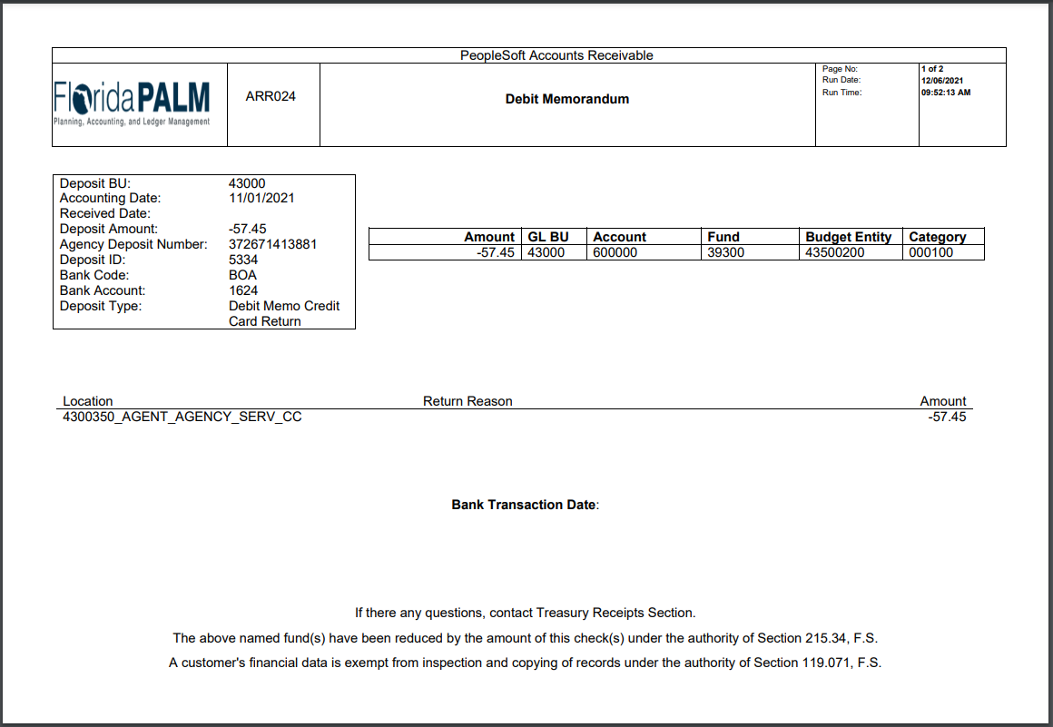
85000
8500351_AGENT_AGENCY_SERV_CC

Slide 17
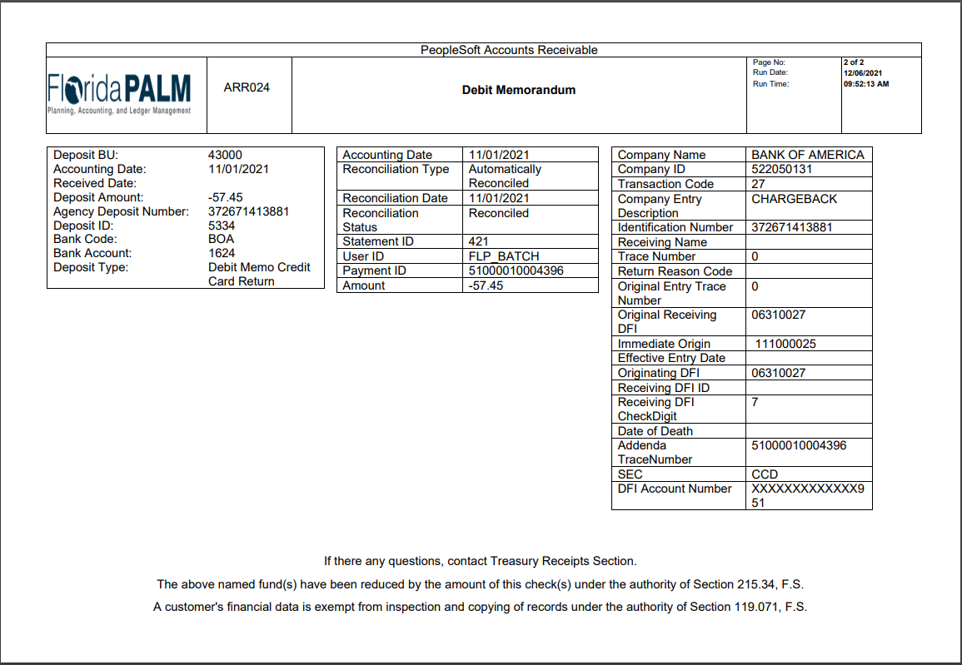

Slide 18
Tips & Tricks for Monitoring Deposits
Create FLAIR Transaction

Slide 19
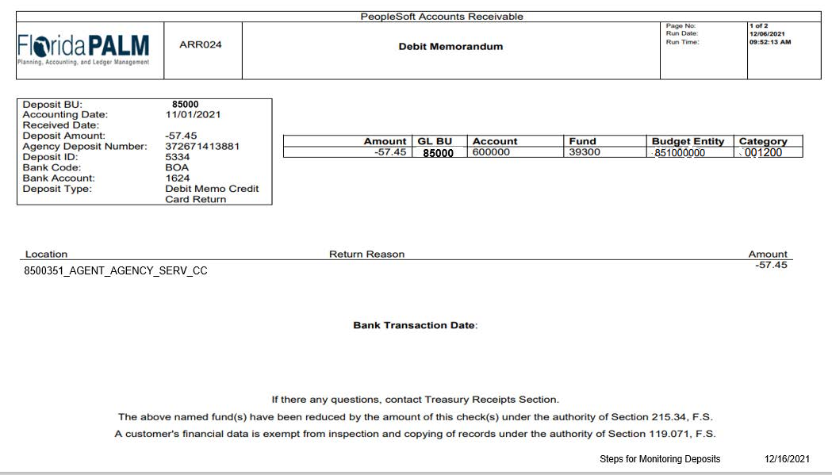
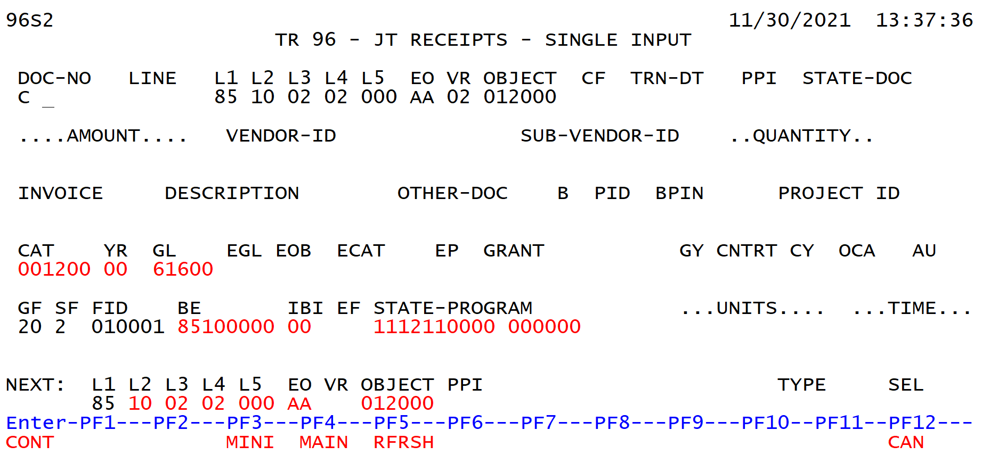
Tips & Tricks for Monitoring Deposits

Slide 20
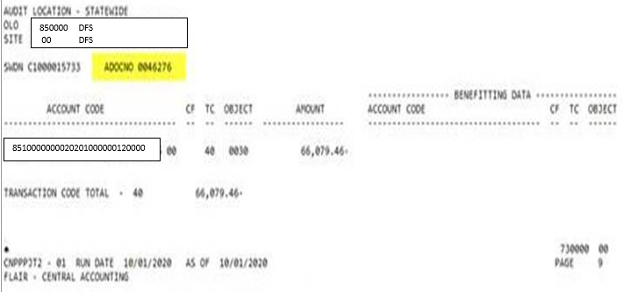
Tips & Tricks for Monitoring Deposits
JT2 Report from Central FLAIR

Slide 21
Tips & Tricks for Monitoring Deposits
What should I use a TR30N or a TR96?
This is an agency preference
What is the difference between a TR30N and TR96?
TR30 done with a bookkeeping indicator (N) treats the TR30 as a TR96, which is a departmental transaction.

Slide 22
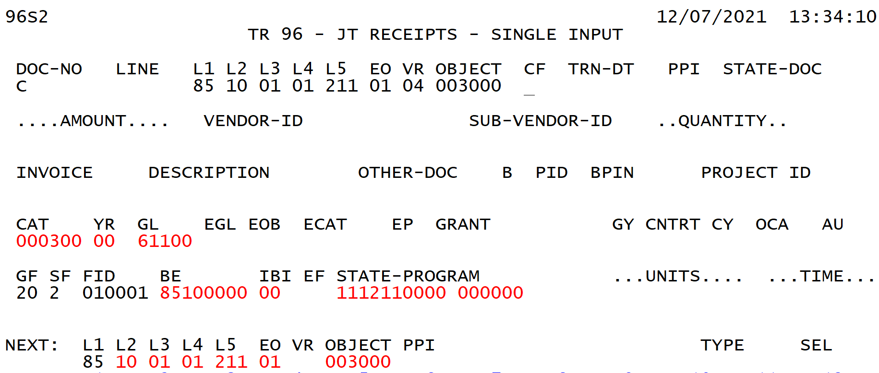
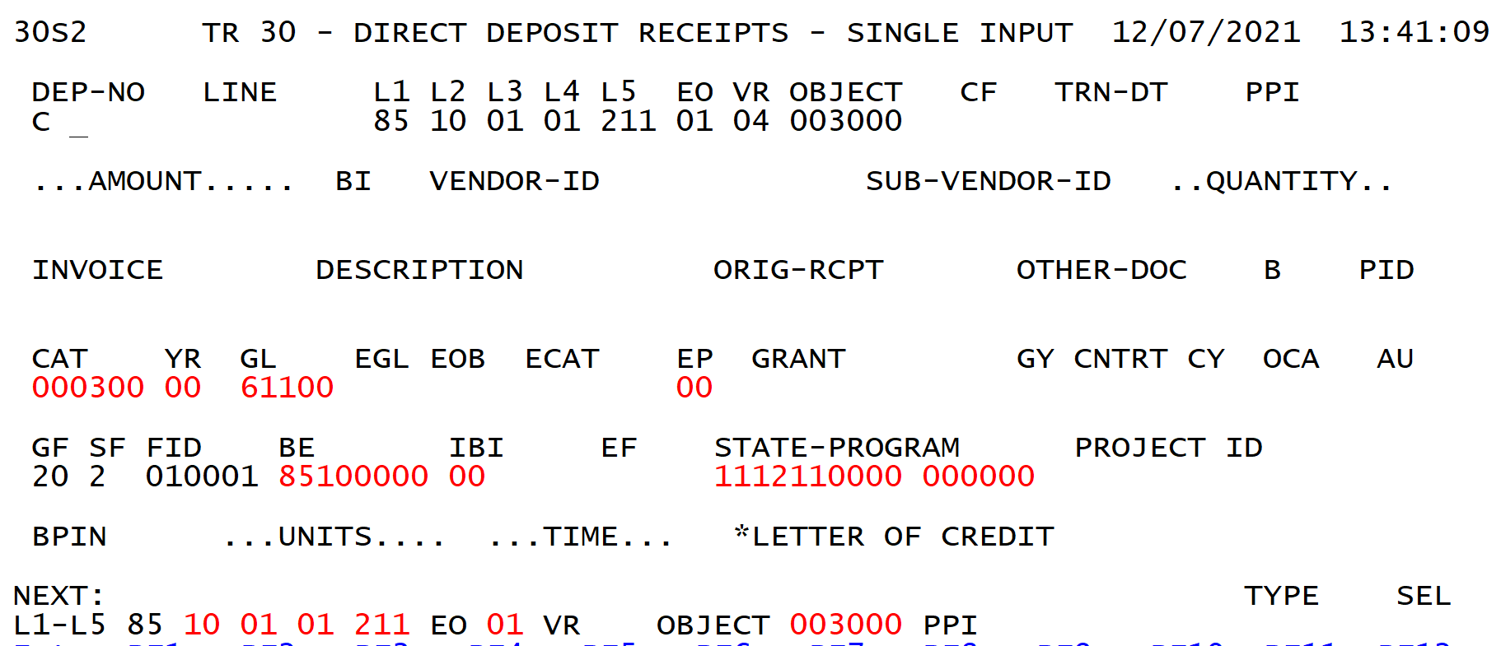
Tips & Tricks for Monitoring Deposits

Slide 23
Tips & Tricks for Monitoring Deposits
Live Demo in FLAIR
This Photo by Unknown Author is licensed under CC BY-NC

Slide 24
Tips & Tricks for Monitoring Deposits
Run Reports
Check agency funding source, if changes are needed
Create Zero Treasury receipt
Negative TR30 from current funding source
Positive TR30 to new funding source
Transfer or (T) to Treasury to keep Departmental FLAIR and Central FLAIR in balance with Florida PALM.

Slide 25
Tips & Tricks for Monitoring Deposits
Run Reports

Slide 26
Tips & Tricks for Monitoring Deposits

Slide 27
Contact Information
Contact us
FloridaPALM@myfloridacfo.com
Project Website
www.myfloridacfo.com/floridapalm/

