Slide 1
Florida State Treasury Investments
May 31, 2024

Slide 2
Treasury Investment Portfolio
 | May 31, 2024
Treasury Investment Portfolio
(Internally and Externally Managed Portfolios) | $63,510,524,666.37

Slide 3
Portfolio Allocation as of
May 31, 2024

Slide 4
Treasury Participants as of May 31, 2024

Slide 5
Net Earnings Rate
(past 12 months)
Rates are unaudited

Slide 6
Annualized Net Earnings Rate as of May 31, 2024
Rates are unaudited

Slide 7
Total Treasury Investment Portfolio Monthly Sector Distribution

Slide 8
Total Treasury Investment Portfolio
Quality Distribution
S&P Ratings
*Includes Repos collateralized with US Government securities

Slide 9
Total Treasury Investment Portfolio
Effective Duration

Slide 10
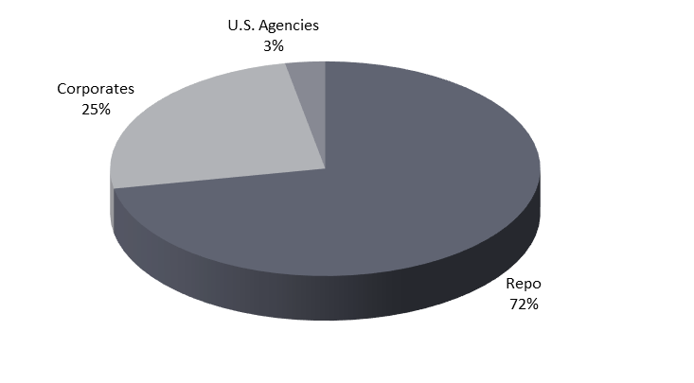
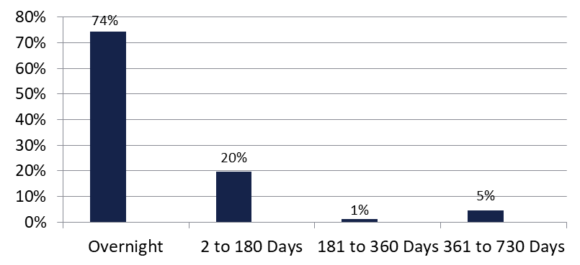

Securities Lending - Cash Collateral Portfolio As of May 31, 2024
Portfolio Characteristics
Credit Quality (S&P) | % of Cost | Cost (in mil.)
U.S. Govt. Securities* | 75.42% | $1,934.6
AAA | 0% | $0
AA | 5.45% | $139.8
A | 19.13% | $490.8
Total Market Value $2,565.2 million
NAV 1.0001
Yield (360 basis) 5.410%
WAM 47 days
* Includes Repos that are collateralized by U.S. Govt. Securities.
Asset Class
Final Maturity Schedule

