Slide 1
Treasury Investment Council Meeting Date: May 30, 2024

Slide 2
Florida Economy & Pool Balances

Slide 3
Florida Economy
July 2023 unemployment rate:
U.S. 3.7%
FL: 3.0%
Consumer Perceptions -- Over the past 18 months, consumer sentiment had improved to 71.6 in July 2023 and 71.2 in August 2023, but has since declined. The reading was 69.7 in December 2023 and still remains below the long-run average (85.0). The National Economic Estimating Conference suggests sentiment will not move above the average until FY 2025-26.
Population Growth -- Florida is currently the third most populous state, behind California and Texas, with 21,538,187 permanent residents recorded as part of the 2020 Census.

Slide 4
FL Treasury Investment Pool Size (total mkt. value)

Slide 5
State Net Receipts (Including Federal Stimulus)

Slide 6
State Operating Accounts

Slide 7
Non-State Operating Accounts*
* Subject to Floor Provision

Slide 8
Bond Accounts

Slide 9
Non-State Operating & Bond Accounts by type
Non-State Operating
Bond
Participant | 3/31/24 balance | % of Pool
Universities | $1,107,928,091.12 | 1.82%
School Boards | $224,033,478.15 | 0.37%
Colleges | $145,329,482.91 | 0.24%
Miscellaneous | $71,810,898.08 | 0.12%
University Component Units | $65,200,682.32 | 0.11%
State Component Units | $30,891,284.49 | 0.05%
College Component Units | $24,571,752.68 | 0.04%
Counties | $6,261,725.53 | 0.01%
Cities | $5,068,512.40 | 0.01%
Grand Total | $1,681,095,907.68 | 2.76%
Participant | 3/31/24 balance | % of Pool
Florida Housing Finance Corp. | $1,332,928,931.89 | 2.19%
Universities | $56,485,331.58 | 0.09%
University Component Units | $56,336,954.44 | 0.09%
State Component Units | $3,727,540.70 | 0.01%
School Boards | $534.60 | 0.00%
Grand Total | $1,449,479,293.21 | 2.38%
*Miscellaneous includes various associations, foundations, and finance corporations.

Slide 10
Summary of Macro Risks to the Investment Pool
Risk | Status | Risk Level
Florida Economy | Unemployment rate continues to be stable/low Population continues to grow | Low
State Net Receipts | Continues to be strong/stable, although slight decrease in first and second quarter | Low
Pool Balance | The total pool balance has remained relatively stable in the past year. Continue to watch legislative spending models. | Low
Non-State Agency SPIA | Non-State Agency Operating accounts continues to decrease and is now at 2.76%. | Low

Slide 11
Investment Pool Distributed Income
Pool Average Balance (in billions)
Average Return (net of fees)
$22.3 | $23.6 | $24.7 | $23.3 | $24.1 | $26.5 | $32.8 | $48.3 | $62.6 | $64.2
1.46% | 1.42% | 1.45% | 1.66% | 2.32% | 3.16% | 1.61% | 0.73% | 1.64% | 2.78%

Slide 12
Miscellaneous Updates
Additional flexibility given to non-State Pool participants by lowering the minimum balance requirement (floor provision) from 60% to 40% of the past 90-day average balance.
Global Custody and Securities Lending Contract under a six-month extension (July 24th).

Slide 13
Securities Lending Review

Slide 14
SECURITIES LENDING OVERVIEW
as of March 31, 2024
 | Market Value Securities on Loan | Market Value Collateral Received | Collateral Coverage | Market Value of Cash Reinvestments | NAV
Cash | $2,829,887,817 | $2,888,150,984 | 102.06% | $2,888,533,070 | 1.0001
Non - Cash | $7,631,096,755 | $7,805,222,225 | 102.28% | N/A | N/A
Total | $10,460,984,572 | $10,693,373,209

Slide 15
Securities Lending Income

Slide 16
Securities Lending - Cash Collateral Portfolio As of March 31, 2024
Portfolio Characteristics
Credit Quality (S&P) | % of Cost | Cost (in mil.)
U.S. Govt. Securities* | 86.19% | $2,489.3
AAA | 0% | $0
AA | 5.32% | $153.8
A | 8.49% | $245.1
Total Market Value $2,888.2 million
NAV 1.0001
Yield (360 basis) 5.391%
WAM 33 days
* Includes Repos that are collateralized by U.S. Govt. Securities.
Asset Class
Final Maturity Schedule

Slide 17
Investment Pool Review

Slide 18
Investments Recap
All actively managed portfolios outperforming their benchmarks.
Record earnings being generated and distributed to participants.
Created a new portfolio, the Passive account.
Successfully transitioned for T+1 settlement for corporate and muni securities.
In the process of allowing Managers to sign MSFTA agreements on our behalf to continue investing in delayed settled mortgages.

Slide 19
Investments Recap (continued)
Maintaining external Managers ability to realize losses in excess of generated income ($1 million since July 2023).
Restarted quarterly meetings and due diligence visits with External Managers
Placed two Managers on watch due to qualitative factors
Small changes to CIP to allow for incremental increase in earnings potential without adding significant risk (see next three slides):

Slide 20
CIP Review - Most Relevant Updates (I)
Added flexibility to the Intermediate Duration Portfolio IP:
Removed sector limits
Added Non-Agency MBS and TBA’s as permitted securities
Removed restrictions related to types of MBS allowed
Made guidelines for non-Agency MBS product consistent amongst all mandates:
Only senior tranches allowed (no mezzanine or subordinated)
AAA rated required
No Alt-A or subprime allowed

Slide 21
CIP Review - Most Relevant Updates (II)
Allow for the purchase of securities issued under 3(a)4 of the 1933 Securities Act in the Intermediate and Long Duration mandates:
3(a)4 exemption is for non-profit entities such as Universities and health care systems e.g. Harvard, Yale and Mayo Clinic
These entities are already allowed under a municipal conduit issuer.
Must be rated in the three highest classifications (A- or better) by at least two ratings agencies.
Eliminated the maximum maturity of seven days for CP in the Short Duration Portfolio.

Slide 22
CIP Review - Most Relevant Updates (III)
Created a U.S. Government guaranteed ABS section in the Long Duration portfolio (to mimic Intermediate Duration portfolio).
Small changes to the Asset Backed Securities section of IPs related to Subprime Auto ABS:
Added clarity to language on which tickers are allowed
Extended WAL from less than 2 years to less than 2.25 years
Minimum deal and ticker amounts outstanding now measured at time of purchase.

Slide 23
Economic and Market Environment

Slide 24
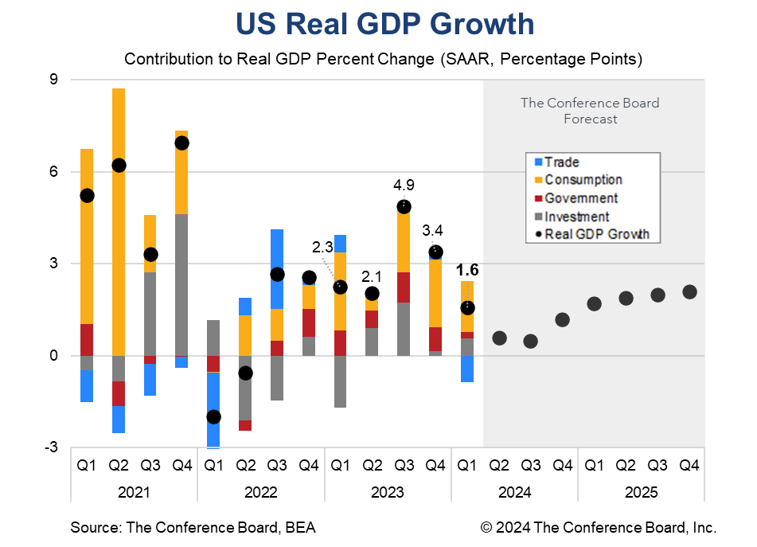
1st Quarter GDP
Consumption grew 2.5%, with services up 4%, and goods -0.4%.
The rise is service spending was primarily driven by increases in healthcare, financial services, and insurance.

Slide 25
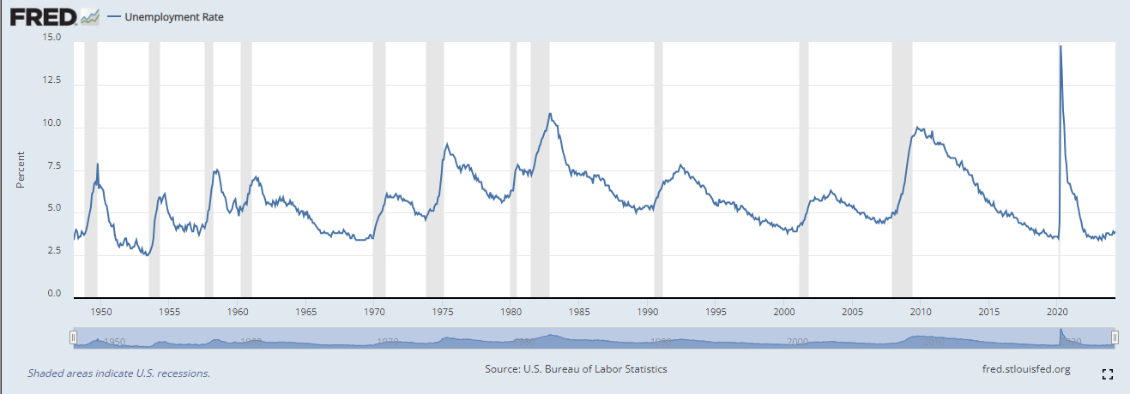
Unemployment

Slide 26
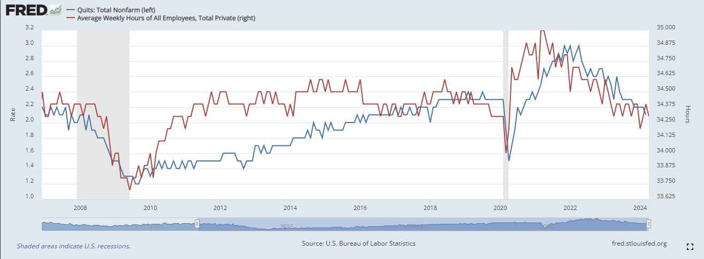
Labor Market Normalizing?

Slide 27
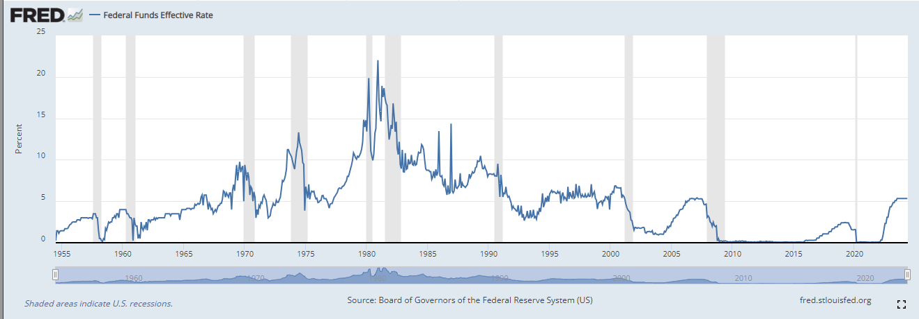
Fed Funds Rate

Slide 28
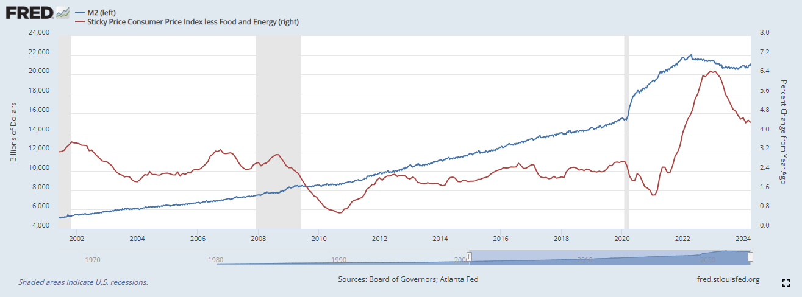
Inflation vs Money Supply

Slide 29
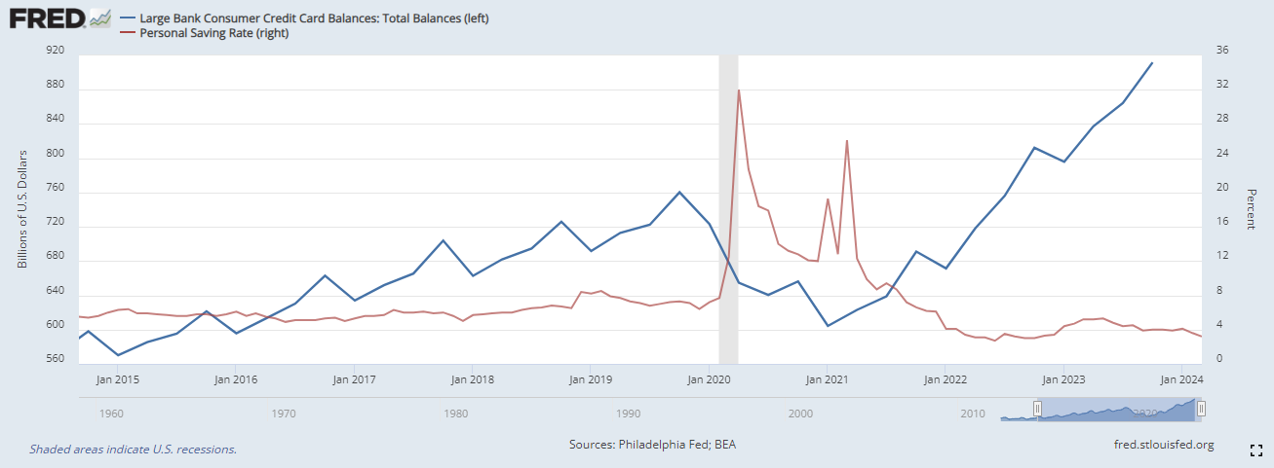
Consumer

Slide 30
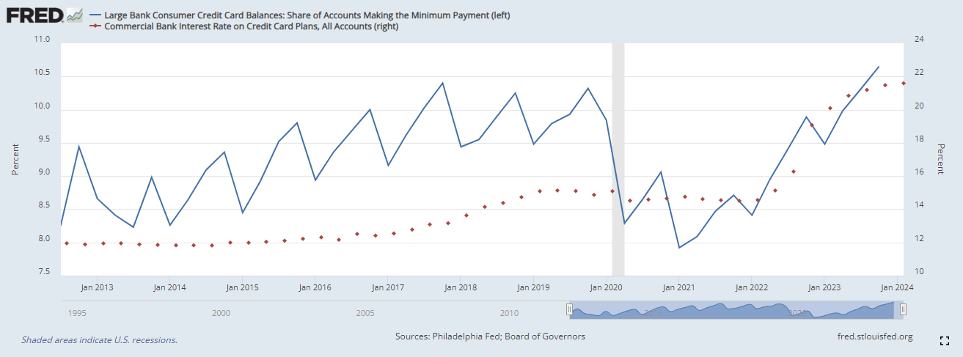
Borrowing at Higher Rates

Slide 31
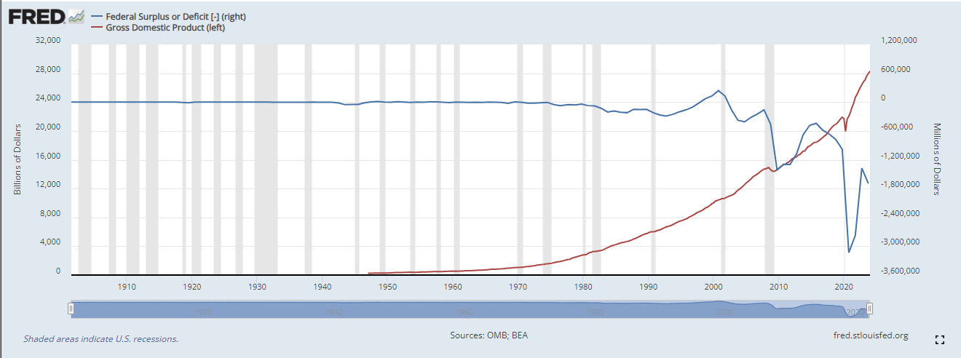
Federal Deficit vs GDP

Slide 32
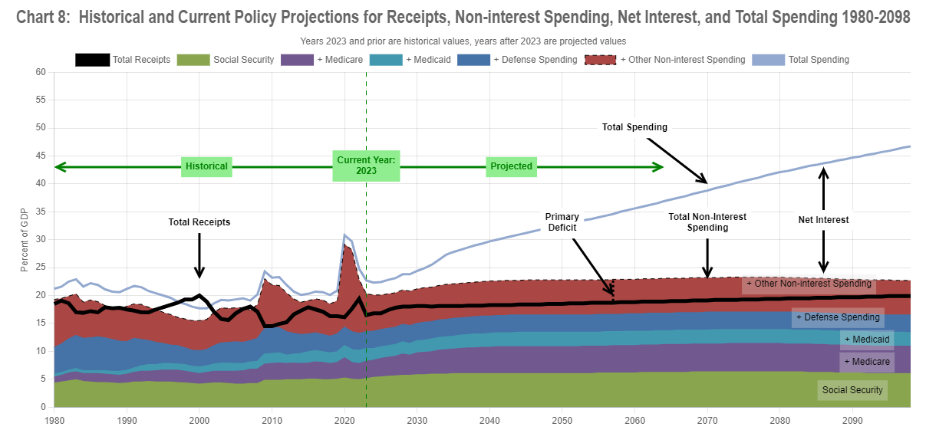

Slide 33
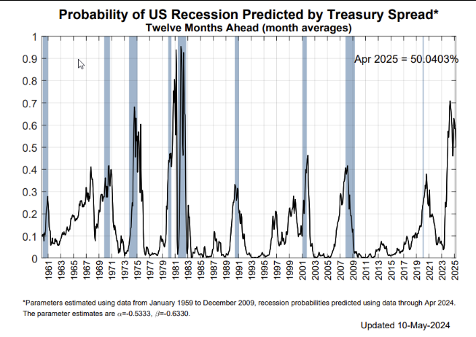

Slide 34
Treasury Yield Curve (Jun 2021 vs Mar 2024)

Slide 35
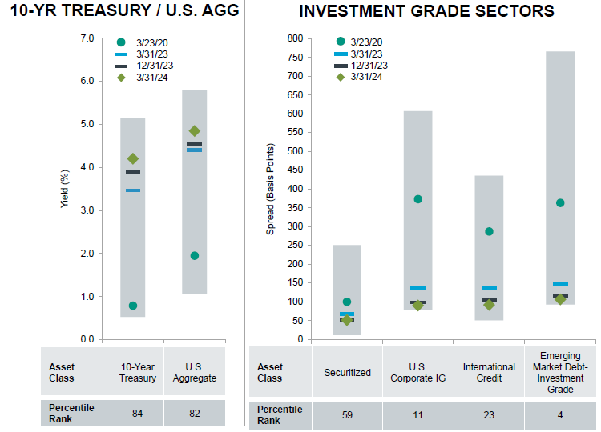
Fixed Income Yields and Spreads
20- year rate and spread ranges
Source: Fidelity Investments

Slide 36
Portfolio Positioning & Performance

Slide 37
Investment Strategy (Macro level)
Macro View
Economic slowdown delayed but not avoided.
Growth can continue to be resilient but inflation should be coming down.
Rate cuts still more likely than rate hikes
Spread sectors trading at very tight levels. Waiting for better reentry point to increase exposure to corporate sector. Favor ABS sector for Internal portfolios as the best way to add carry.
After reallocating $34.2 billion over the past three years from the Liquidity portfolio to higher duration portfolios we are taking a pause and closely monitoring State Pool balances before making further reallocation decisions.

Slide 38
Investment Pool Allocation

Slide 39
Total Pool Characteristics

Slide 40
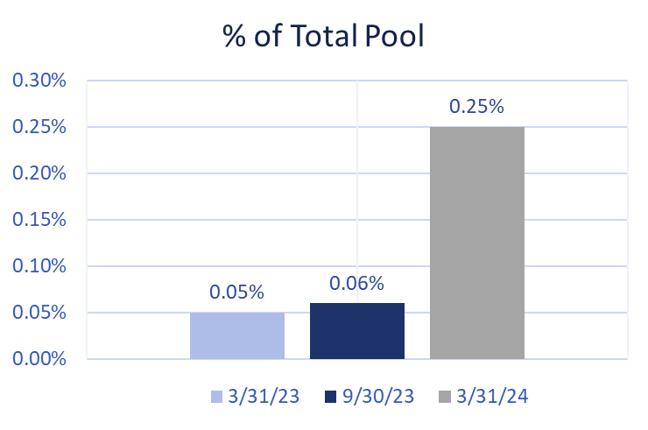
BBB & Lower Exposure
 | Exposure 9/30/2023 | Exposure 3/31/2024 | Limit
Ultra Short Duration | 0.2% | 0.3% | 3%
Short Duration | 2.2% | 2.8% | 7.5%
Intermediate Duration | 8.7% | 8.5% | 10%
Long Duration | 13.3% | 13.7% | 15%
Basket Clause
Statutes allow for 3% in
basket clause items

Slide 41
Top 5 Non-US Govt Holdings as of March 31, 2024
ISSUER | MARKET VALUE | % OF TOTAL | S&P LONG TERM RANKING
Bank of America Corp | $467.3 million | 0.76% | A-
JPMorgan Chase & Co | $371.8 million | 0.61% | A-
Morgan Stanley | $330.2 million | 0.54% | A-
Wells Fargo | $250.8 million | 0.41% | BBB+
Citigroup Inc | $203.5 million | 0.33% | BBB+

Slide 42
Pool Rating
Policy requirement: A+ or better using S&P rating matrix
S&P Rating as of March 31, 2024 = AA-f
Credit Score as of March 31, 2024 = 62.09 (AA-f) (vs. 56.83 Sep. 30, 2023)
S&P rating matrix
Maximum Score | Rating
18.49 | AAAf
37.49 | AA+f
58.49 | AAf
91.49 | AA-f
120.49 | A+f
184.49 | Af
290.49 | A-f
360.49 | BBB+f

Slide 43
U.S. Fixed Income Markets Returns
Q4 - 2023 & Q1 - 2024
Treasuries
Spread Sectors
 | 9/30/2023 | 3/31/2024 | Period Change
3-month T-Bill | 5.451% | 5.371% | -8.0 b.p.
2 Year T-Note | 5.046% | 4.621% | -42.5 b.p.
5 Year T-Note | 4.611% | 4.213% | -39.7 b.p.
10 Year T-Note | 4.572% | 4.201% | -37.1 b.p.
30 Year T-Note | 4.701% | 4.344% | -35.8 b.p.
 | 09/30/2023 | 03/31/2024 | Period Change
Agency | 23 | 20 | -3
Corp – IG | 121 | 90 | -31
Corp – HY | 394 | 299 | -95
MBS | 66 | 49 | -17
ABS | 67 | 55 | -11
CMBS | 130 | 96 | -34
Source: Bloomberg

Slide 44
Investment Pool Q4 2023 & Q1 2024 Total Returns vs Benchmarks (excl. Time Deposits)

Slide 45
Investment Pool Total Return (excl. Time Deposits)
* Annualized

Slide 46
Individual Mandates Review

Slide 47
Liquidity & STIF Portfolios (as of March 31, 2024)
Liquidity Portfolio
 | 6 Mo* | 1 Year | 3 Year | 5 Year
Portfolio | 2.73 | 5.37 | 2.54 | 1.97
Benchmark | 2.70 | 5.33 | 2.64 | 2.01
Excess Return | 0.03 | 0.04 | -0.10 | -0.04
Primary goal is to provide funds to cover disbursements and help the entire pool maximize income. Performance versus benchmark is sometimes a secondary concern.
Due to maturity extension, portfolios benefited from the slight decline in short-term rates. Choosing the highest yielding investments in the space to try to maintain a slight yield advantage.
Continue to maximize exposure to the 3 -12 month part of the yield curve mostly through T-bills as rate have peaked. This exposure will greatly benefit performance if and when Federal Reserve initiates next rate-cut cycle.
Maximizing Commercial Paper use in the very short-term space and finding attractive rates in Repos. Opportunistically taking advantage of Agency discount notes and T-bills to extend duration
STIF Portfolio
 | 6 Mo* | 1 Year | 3 Year | 5 Year
Portfolio | 2.94 | 6.15 | 2.83 | 2.06
Benchmark | 2.70 | 5.33 | 2.64 | 2.01
Excess Return | 0.24 | 0.81 | 0.19 | 0.04
Information provided by BNY Mellon.
* not annualized.

Slide 48
Ultra Short Duration Portfolio - Performance and Attribution
ATTRIBUTION NOTES
TOTAL RETURNS
as of March 31, 2024
4th Quarter 2023 and 1st Quarter of 2024 ( +11.6 b.p.)
+ Duration / Yield Curve: The portfolio’s Duration strategy has shifted from an underweight bias to a more neutral stance as rates have risen. The strategy contributed positively to performance over the period driven by tactical plays around end-of-month rebalancing. Due to the inverted yield curve, the portfolio continues to favor a slightly barbell structure to gain a slight yield advantage.
+ Cross-Sector: The portfolio’s sector allocation decisions contributed to performance over the period. The underweight to treasuries and exposure to spread sectors (mostly ABS) was additive in a period where spreads compressed. ABS has more than doubled the yield per duration, when compared to corporate securities (1.973 vs. 0.756). The reduction of 2% in corporate sector exposure from a year ago, was more than compensated by the increase in the ABS sector.
+ Yield: The portfolio has maintained a healthy yield/carry advantage versus the benchmark during the period. Yield curve positioning, sector selection and participation in new issue market have all contributed to this yield advantage.
 | 6 Mo* | 1 Year | 3 Year | 5 Year
Portfolio | 2.80 | 4.43 | 1.47 | 1.69
Benchmark | 2.69 | 4.21 | 1.38 | 1.63
Excess Return | 0.11 | 0.22 | 0.09 | 0.06
Information provided by BNY Mellon.
* not annualized.

Slide 49
Ultra Short Duration Portfolio - Current Strategy / Characteristics
Current Strategy
Portfolio Characteristics Summary
Duration / Yield Curve | It may be time to shift strategy to a longer duration. This is based on the idea that the FED next move is a rate cut. Still maintain a barbell structure to add yield and will continue to play duration tactically at end of month rebalancing.
Credit / Other Spread Sectors | Continue to favor ABS versus Corporates. Waiting for a better re-entry point in corporates as spreads have been tight. New purchases done almost exclusively in the primary market despite narrow new issue concessions.
Other | Continue to maximize the use of “swing trades” to save on trading costs.
 | Yield | Duration | Non- Treasuries % | BBB %
ICEML 0-2 Yr US Treasuries Index 3/31/2024 | 4.99 | 0.98 | 0.0 | 0.0
PORTFOLIO:
3/31/2024 | 5.13 | 0.96 | 9.12 | 0.34
9/30/2023 | 5.37 | 0.97 | 7.60 | 0.23
3/31/2023 | 4.62 | 0.97 | 7.57 | 0.17
Data obtained from BNYM / Wilshire / Bloomberg

Slide 50
Ultra Short Duration Portfolio – Portfolio Characteristics (continued)

Slide 51
Short Duration Portfolio - Performance and Attribution
TOTAL RETURNS
as of March 31, 2024
ATTRIBUTION NOTES
4th Quarter 2023 and 1st Quarter 2024 ( +13 b.p.)
+ Duration / Yield Curve: The portfolio’s Duration strategy contributed positively to performance over the period. Performance was driven by our tactical position and end-of-month rebalancing strategy. The slight barbell structure vs benchmark was also additive as it increased portfolio yield/carry.
+ Cross-Sector: Our cross-sector position contributed to performance due to our sector underweight to treasuries and overweight to ABS. This was slightly offset by the portfolio’s smaller contribution to duration coming from the corporate sector.
+ Yield: We maintained a benchmark-relative yield advantage through a majority of the period due to curve positioning and sector selection
 | 6 Mo* | 1 Year | 3 Year | 5 Year
Portfolio | 3.11 | 3.65 | 0.37 | 1.41
Benchmark | 2.98 | 3.29 | 0.20 | 1.29
Excess Return | 0.13 | 0.36 | 0.17 | 0.13
Information provided by BNY Mellon.
* not annualized.

Slide 52
Short Duration Portfolio - Current Strategy / Portfolio Characteristics
Current Strategy
Portfolio Characteristics Summary
Duration / Yield Curve | We have become neutral on duration as rates seem to have peaked. Continue to do short-term tactical plays mostly around end of month rebalancing. Due to the curve inversion, we are maintaining a slight barbell structure to increase overall yield.
Cross-Sector | Given the current low spread levels, we have a neutral position to the corporate sector as we wait for opportunities to add at more attractive levels. Continue to favor the ABS sector given its better valuation metrics.
Other | Continue to maximize the use of “swing trades” to save on trading costs and prefer new issue vs secondary when looking to add corporates.
 | Yield | Duration | Duration % > 3 Years | % BBB
ICEML 1-3Yr A-AAA US Corp & Gov. Index 3/31/2024 | 4.81 | 1.83 | 0.0 | 2.7
Portfolio:
3/31/2024 | 5.03 | 1.81 | 3.9 | 2.8
9/30/2023 | 5.27 | 1.86 | 12.7 | 2.2
3/31/2023 | 4.39 | 1.83 | 6.5 | 3.1
Data obtained from BNYM / Wilshire / Bloomberg

Slide 53
Short Duration Portfolio – Portfolio Characteristics (continued)

Slide 54
Short Duration Portfolio – Portfolio Characteristics (continued)

Slide 55
Intermediate Duration Portfolio Net of Fee Performance as of March 31, 2024
 | % of |  | Mgr |  |  |  |  |  |  |  |  | Annualized
 | Inv. Pool | Market Value | Rank* | 1 Month |  | 3 Month |  | 6 Month |  | 1 Year |  | 2 Year |  | 3 Year |  | 5 Year |  | 7 Year |  | 10 Year
IR+M | 3.27% | $2,001,329,748.63 | 2 | 0.851% | 4 | -0.063% | 3 | 5.468% | 3 | 3.081% | 3 | 0.336% | 2 | -1.223% | 2 | 1.147% | 2 | 1.510% | 2 | 0.017 | 3
MetWest | 3.18% | $1,944,490,990.15 | 4 | 0.846% | 5 | -0.568% | 6 | 5.091% | 6 | 2.271% | 6 | -0.306% | 4 | -1.566% | 4 | 0.876% | 4 | 1.323% | 4 | 0.015 | 4
Galliard | 3.00% | $1,834,347,353.79 | 3 | 0.868% | 3 | -0.047% | 2 | 5.542% | 1 | 3.215% | 2 | 0.147% | 3 | -1.337% | 3 | 1.009% | 3 | 1.469% | 3 | 0.017 | 1
Sterling Capital | 2.95% | $1,802,049,639.51 | 1 | 0.942% | 1 | 0.016% | 1 | 5.513% | 2 | 3.387% | 1 | 0.449% | 1 | -1.014% | 1 | 1.224% | 1 | 1.605% | 1 | 0.017 | 2
Reams Asset Mgmt | 2.04% | $1,244,544,339.14 | NR | 0.885% | 2 | -0.175% | 4 | 5.263% | 4 | 2.929% | 4
Wellington Mgmt Co | 2.03% | $1,240,652,666.09 | NR | 0.809% | 6 | -0.366% | 5 | 5.138% | 5 | 2.611% | 5
Total | 16.46% | $10,067,414,737.31 |  | 0.868% |  | -0.195% |  | 5.350% |  | 2.925% |  | 0.136% |  | -1.301% |  | 1.055% |  | 1.473% |  | 0.016
Benchmark |  |  |  | 0.779% |  | -0.416% |  | 5.059% |  | 2.304% |  | -0.275% |  | -1.663% |  | 0.615% |  | 1.088% |  | 0.014
* Based on 1, 3 and 5 Year Risk Adjusted Rankings.

Slide 56
Long Duration Portfolio Net of Fee Performance as of March 31, 2024
 | % of | Market Value | Mgr |  |  |  |  |  |  |  |  | Annualized
 | Inv. Pool |  | Rank* | 1 Month |  | 3 Month |  | 6 Month |  | 1 Year |  | 2 Year |  | 3 Year |  | 5 Year |  | 7 Year |  | 10 Year |  | 15 Year |  | 20 Year |  | 25 Year
Galliard | 4.36% | $2,668,279,980.25 | 1 | 1.068% | 6 | -0.379% | 2 | 6.532% | 4 | 2.491% | 4 | -1.232% | 3 | -2.054% | 2 | 0.948% | 1 | 1.591% | 1 | 2.078% | 1
All Spring (Wells) | 4.35% | $2,660,147,191.06 | 5 | 1.054% | 8 | -0.498% | 5 | 6.321% | 8 | 2.430% | 6 | -1.523% | 10 | -2.269% | 9 | 0.773% | 5 | 1.412% | 5 | 1.829% | 4 | 3.092% | 9 | 3.326% | 4
Fidelity | 4.16% | $2,547,011,608.20 | 8 | 0.993% | 10 | -0.796% | 11 | 6.065% | 11 | 1.972% | 10 | -1.624% | 11 | -2.215% | 8 | 0.767% | 6 | 1.404% | 6 | 1.801% | 7 | 3.236% | 7 | 3.486% | 2 | 4.294% | 2
Sterling Capital | 3.86% | $2,360,395,441.14 | 3 | 1.106% | 1 | -0.338% | 1 | 6.448% | 7 | 2.652% | 3 | -0.971% | 1 | -1.938% | 1 | 0.905% | 2 | 1.569% | 2 | 1.975% | 2 | 3.246% | 5
Goldman Sachs | 3.17% | $1,938,431,520.88 | 7 | 1.003% | 9 | -0.600% | 8 | 6.270% | 9 | 2.210% | 8 | -1.406% | 6 | -2.188% | 6 | 0.777% | 4 | 1.422% | 3 | 1.743% | 9 | 3.191% | 8 | 3.230% | 5 | 4.096% | 5
Amundi | 3.08% | $1,881,650,281.92 | 2 | 1.074% | 3 | -0.492% | 4 | 6.616% | 2 | 2.884% | 1 | -1.097% | 2 | -2.109% | 3 | 0.820% | 3 | 1.420% | 4 | 1.926% | 3 | 3.829% | 1 | 3.529% | 1 | 4.358% | 1
Western Asset | 2.84% | $1,734,145,844.10 | 10 | 1.074% | 4 | -0.625% | 10 | 6.480% | 5 | 2.178% | 9 | -1.406% | 7 | -2.191% | 7 | 0.626% | 9 | 1.325% | 9 | 1.827% | 5 | 3.557% | 3 | 3.229% | 6 | 4.127% | 4
Manulife | 2.80% | $1,709,392,809.53 | 9 | 1.091% | 2 | -0.561% | 6 | 6.460% | 6 | 2.215% | 7 | -1.439% | 8 | -2.271% | 10 | 0.648% | 8 | 1.377% | 7 | 1.805% | 6 | 3.615% | 2 | 3.370% | 3 | 4.196% | 3
PGIM | 2.36% | $1,442,890,916.02 | 4 | 1.070% | 5 | -0.423% | 3 | 6.623% | 1 | 2.731% | 2 | -1.298% | 4 | -2.275% | 11 | 0.625% | 10 | 1.334% | 8 | 1.787% | 8 | 3.237% | 6
Nuveen | 1.33% | $815,407,017.24 | 11 | 0.987% | 11 | -0.615% | 9 | 6.084% | 10 | 1.898% | 11 | -1.485% | 9 | -2.172% | 4 | 0.578% | 11 | 1.242% | 11 | 1.597% | 11 | 3.476% | 4 | 3.204% | 7 | 4.017% | 6
Insight Investment | 1.16% | $711,294,354.74 | 6 | 1.063% | 7 | -0.594% | 7 | 6.532% | 3 | 2.453% | 5 | -1.341% | 5 | -2.178% | 5 | 0.713% | 7 | 1.296% | 10 | 1.712% | 10
Total | 33.47% | $20,469,046,965.08 |  | 1.055% |  | -0.530% |  | 6.395% |  | 2.378% |  | -1.351% |  | -2.183% |  | 0.755% |  | 1.403% |  | 1.818% |  | 3.326% |  | 3.222% |  | 4.033%
Benchmark |  |  |  | 0.923% |  | -0.776% |  | 5.989% |  | 1.698% |  | -1.596% |  | -2.456% |  | 0.362% |  | 1.061% |  | 1.545% |  | 2.618% |  | 2.994% |  | 3.840%
* Based on 1, 3 and 5 Year Risk Adjusted Rankings.

Slide 57
Fixed Income Characteristics (as of March 31, 2024)
Intermediate Duration Composite
 | Portfolio | Benchmark
Coupon | 3.49% | 3.17%
YTM | 4.91% | 4.71%
Effective Duration | 4.51 years | 4.46 years
Long Duration Composite
 | Portfolio | Benchmark
Coupon | 3.79% | 3.30%
YTM | 5.15% | 4.85%
Effective Duration | 6.17 years | 6.15 years

Slide 58
Sector Allocation

Slide 59
Credit Quality (Moody’s)

Slide 60
Overall Ranking Using Absolute and Risk-Adjusted Returns
Rankings Based on 1, 3 and 5 Year Risk / Return Metrics

Slide 61
Recent Actions
Put Manulife and Insight on Watch (Manulife – Jan 2024 ; Insight March 2024) for qualitative reasons:
Both had a sudden change in lead PM on our account (left firm) and significant changes in the PM team.
Reduce Manulife assets by $495 million and reallocated to a better performing Manager, Amundi ($165 mm per month).
Due to the reduced size of assets managed and a better rank, no assets were taken from Insight.

Slide 62
Watch List Update – Long Duration
Manulife | Jan-24 | Feb-24 | Mar-24
3 Month Outperformance | Yes | Yes | Yes
Monthly Outperformance | 0.15% | -0.10% | 0.17%
Cumulative Outperformance (Linked) from Watch List Inception | 0.15% | 0.05% | 0.22%
1 Month Return Rank | 5 | 10 | 2
Rolling 3 Month Return Rank | 1 | 5 | 6
1 Year Return Rank | 11 | 11 | 7
Insight | Mar-24
3 Month Outperformance | Yes
Monthly Outperformance | 0.14%
Cumulative Outperformance (Linked) from Watch List Inception | 0.14%
1 Month Return Rank | 7
Rolling 3 Month Return Rank | 7
1 Year Return Rank | 5

Slide 63
Watch List Worksheet – Intermediate Duration (March 31, 2024)
INTERMEDIATE DURATION |  |  | Danger Zone 6 - 8 Months
QUANTITATIVE FACTORS |  |  | Max Exceeded 9 Months
Any of the Following Conditions
(#1) Trailing 5-Year Annualized Net Performance Below Benchmark for 6 of 12 Months
Galliard | IR+M |  |  | MetWest/TCW |  |  | Sterling
(#2) Trailing 3-Year Annualized Net Performance Below Benchmark for 9 out of 12 Months
Galliard | IR+M |  |  | MetWest/TCW |  |  | Sterling
(#3) Mgr's (1 & 3 Year) Risk-Adjusted Ranking LAST for 9 out of 12 Months
Galliard | IR+M |  |  | MetWest/TCW |  |  | Sterling
Aug, July, June, May 23 |  |  |  | Mar, Feb, Jan 24 ; Dec, Nov, Oct, Sept, April 23
(#4) Trailing 1-Year Net Performance Below Benchmark & Bottom Quartile (Last) of Mandate for 9 out of 12 Months
Galliard | IR+M |  |  | MetWest/TCW |  |  | Sterling
April 23 |  |  |  | Mar, Feb 24, Sept 23

Slide 64
Watch List Worksheet – Long Duration (March 31, 2024)
LONG DURATION |  |  |  | Danger Zone 6 - 8 Months
QUANTITATIVE FACTORS |  |  |  | Max Exceeded for 9 Months
Any of the Following Conditions
(#1) Trailing 5-Year Annualized Net Performance Below Benchmark for 6 of 12 Months
AmundiPioneer | Fidelity | Galliard | Goldman | Insight Investment | Manulife | Nuveen | PGIM | Sterling | All Spring (Wells) | Western Asset
(#2) Trailing 3-Year Annualized Net Performance Below Benchmark for 9 out of 12 Months
AmundiPioneer | Fidelity | Galliard | Goldman | Insight Investment | Manulife | Nuveen | PGIM | Sterling | All Spring (Wells) | Western Asset
(#3) Mgr's (1 & 3 Year) Risk-Adjusted Ranking in Bottom Two for 9 out of 12 Months
AmundiPioneer | Fidelity | Galliard | Goldman | Insight Investment | Manulife | Nuveen | PGIM | Sterling | All Spring (Wells) | Western Asset
 | Mar 24 ; Nov, Oct, Sept, July, June, April 23 |  | Jan 24 | Dec, May 23 | Feb, Jan 24 ; Nov, Oct, Sept, July, June 23 | Mar, Feb 24, Dec, Aug 23 | Aug 23 |  | May, April 23
(#4) Trailing 1-Year Net Performance Below Benchmark & Bottom Quartile (Bottom 2) of Mandate for 9 out of 12 Months
AmundiPioneer | Fidelity | Galliard | Goldman | Insight Investment | Manulife | Nuveen | PGIM | Sterling | All Spring (Wells) | Western Asset
 | Sept, July, June, April 23 |  |  |  | Feb 24, Oct, Sept, July, June 23 | Feb 24 | May 23 |  | May, April 23

