Slide 1
Florida State Treasury Investments
January 31, 2025

Slide 2
Treasury Investment Portfolio
 | January 31, 2025
Treasury Investment Portfolio
(Internally and Externally Managed Portfolios) | $62,308,217,394.30

Slide 3
Portfolio Allocation as of
January 31, 2025

Slide 4
Treasury Participants as of January 31, 2025

Slide 5
Net Earnings Rate
(past 12 months)
Rates are unaudited

Slide 6
Annualized Net Earnings Rate as of January 31, 2025
Rates are unaudited

Slide 7
Total Treasury Investment Portfolio Monthly Sector Distribution

Slide 8
Total Treasury Investment Portfolio
Quality Distribution
S&P Ratings
*Includes Repos collateralized with US Government securities

Slide 9
Total Treasury Investment Portfolio
Effective Duration

Slide 10
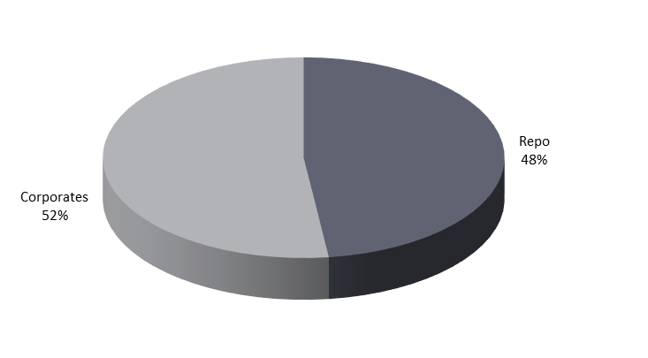
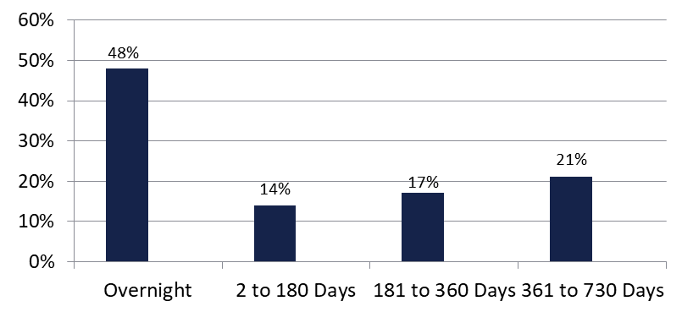

Securities Lending - Cash Collateral Portfolio As of January 31, 2024
Portfolio Characteristics
Credit Quality (S&P) | % of Cost | Cost (in mil.)
U.S. Govt. Securities* | 48.15% | $398.3
AAA | 0% | $0
AA | 22.42% | $185.4
A | 29.43% | $243.4
Total Market Value $827.1 million
NAV 1.0005
Yield (360 basis) 4.572%
WAM 162 days
* Includes Repos that are collateralized by U.S. Govt. Securities.
Asset Class
Final Maturity Schedule

