Slide 1
Florida State Treasury Investments
January 31, 2026

Slide 2
Treasury Investment Portfolio
 | January 31, 2026
Treasury Investment Portfolio
(Internally and Externally Managed Portfolios) | $60,072,685,132.86

Slide 3
Portfolio Allocation as of
January 31, 2026

Slide 4
Treasury Participants
as of January 31, 2026

Slide 5
Net Earnings Rate
(past 12 months)

Slide 6
Annualized Net Earnings Rate
as of January 31, 2026

Slide 7
Total Treasury Investment Portfolio Monthly Sector Distribution

Slide 8
Total Treasury Investment Portfolio
Quality Distribution

Slide 9
Total Treasury Investment Portfolio
Effective Duration

Slide 10
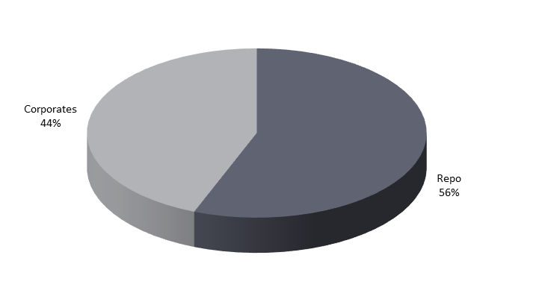
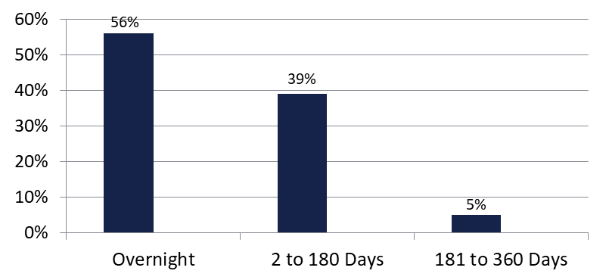

Securities Lending - Cash Collateral Portfolio
As of January 31, 2026
Portfolio Characteristics
Credit Quality (S&P) | % of Cost | Cost (in mil.)
U.S. Govt. Securities* | 55.59% | $220.9
AAA | 0% | $0
AA | 34.35% | $136.6
A | 10.06% | $40.0
Total Market Value $397.5 million
NAV 1.0004
Yield (360 basis) 3.895%
WAM 44 days
* Includes Repos that are collateralized by U.S. Govt. Securities.
Asset Class
Final Maturity Schedule

