Slide 1
Florida State Treasury Investments
February 28, 2025

Slide 2
Treasury Investment Portfolio
 | February 28, 2025
Treasury Investment Portfolio
(Internally and Externally Managed Portfolios) | $62,990,311,917.10

Slide 3
Portfolio Allocation as of
February 28, 2025

Slide 4
Treasury Participants as of February 28, 2025

Slide 5
Net Earnings Rate
(past 12 months)
Rates are unaudited

Slide 6
Annualized Net Earnings Rate as of February 28, 2025
Rates are unaudited

Slide 7
Total Treasury Investment Portfolio Monthly Sector Distribution

Slide 8
Total Treasury Investment Portfolio
Quality Distribution
S&P Ratings
*Includes Repos collateralized with US Government securities

Slide 9
Total Treasury Investment Portfolio
Effective Duration

Slide 10
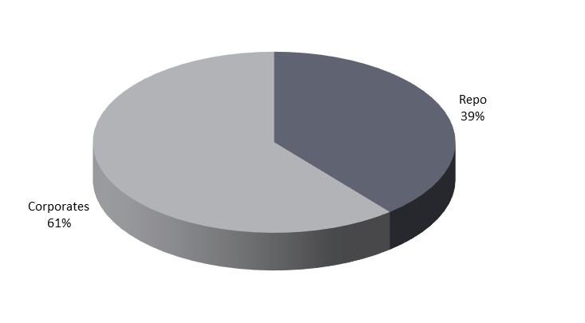
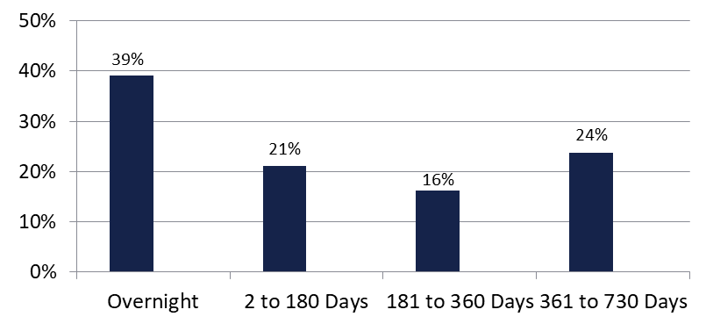

Securities Lending - Cash Collateral Portfolio As of February 28, 2025
Portfolio Characteristics
Credit Quality (S&P) | % of Cost | Cost (in mil.)
U.S. Govt. Securities* | 39.23% | $276.8
AAA | 0% | $0
AA | 26.27% | $185.4
A | 34.50% | $243.4
Total Market Value $705.6 million
NAV 1.0005
Yield (360 basis) 4.609%
WAM 173 days
* Includes Repos that are collateralized by U.S. Govt. Securities.
Asset Class
Final Maturity Schedule

