Slide 1
Florida State Treasury Investments
February 28, 2026

Slide 2
Treasury Investment Portfolio
 | February 28, 2026
Treasury Investment Portfolio
(Internally and Externally Managed Portfolios) | $60,195,965,013.24

Slide 3
Portfolio Allocation as of
February 28, 2026

Slide 4
Treasury Participants
as of February 28, 2026

Slide 5
Net Earnings Rate
(past 12 months)

Slide 6
Annualized Net Earnings Rate
as of February 28, 2026

Slide 7
Total Treasury Investment Portfolio Monthly Sector Distribution

Slide 8
Total Treasury Investment Portfolio
Quality Distribution

Slide 9
Total Treasury Investment Portfolio
Effective Duration

Slide 10
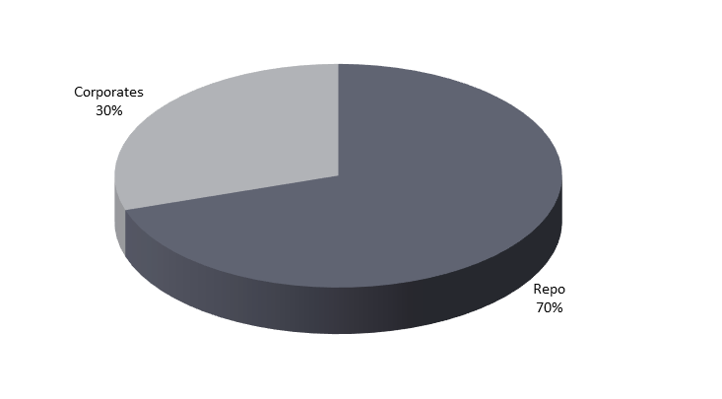
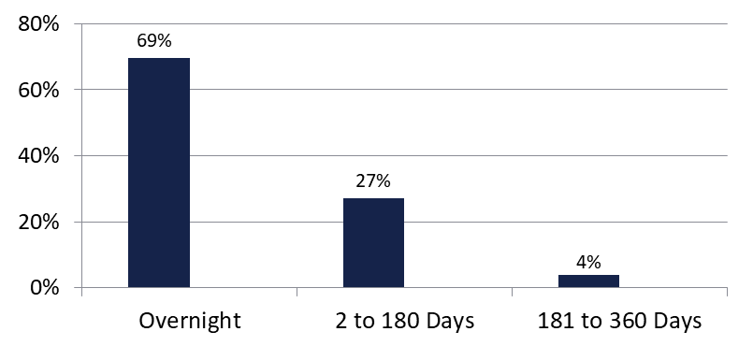

Securities Lending - Cash Collateral Portfolio
As of February 28, 2026
Portfolio Characteristics
Credit Quality (S&P) | % of Cost | Cost (in mil.)
U.S. Govt. Securities* | 69.56% | $380.5
AAA | 0% | $0
AA | 24.96% | $136.5
A | 5.48% | $30.0
Total Market Value $547.0 million
NAV 1.0002
Yield (360 basis) 3.843%
WAM 24 days
* Includes Repos that are collateralized by U.S. Govt. Securities.
Asset Class
Final Maturity Schedule

