Slide 1
Florida State Treasury Investments
February 29, 2024

Slide 2
Treasury Investment Portfolio
 | February 29, 2024
Treasury Investment Portfolio
(Internally and Externally Managed Portfolios) | $61,265,339,985.40

Slide 3
Portfolio Allocation as of
February 29, 2024

Slide 4
Treasury Participants as of February 29, 2024

Slide 5
Net Earnings Rate
(past 12 months)
Rates are unaudited

Slide 6
Annualized Net Earnings Rate as of February 29, 2024
Rates are unaudited

Slide 7
Total Treasury Investment Portfolio Monthly Sector Distribution

Slide 8
Total Treasury Investment Portfolio
Quality Distribution
S&P Ratings
*Includes Repos collateralized with US Government securities

Slide 9
Total Treasury Investment Portfolio
Effective Duration

Slide 10
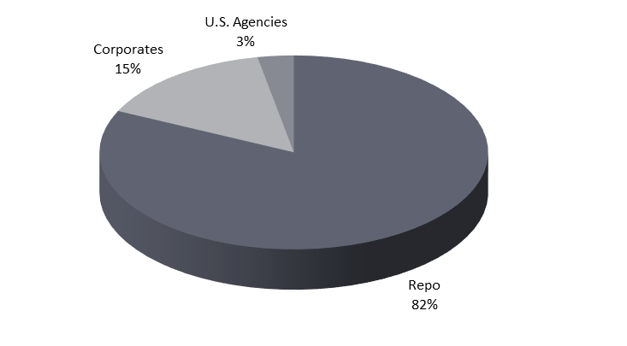
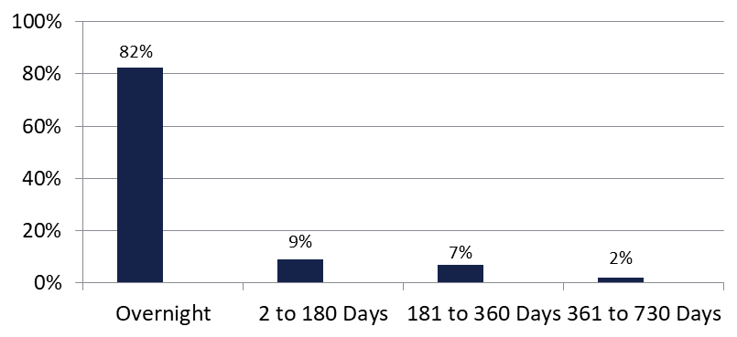

Securities Lending - Cash Collateral Portfolio As of February 29, 2024
Portfolio Characteristics
Credit Quality (S&P) | % of Cost | Cost (in mil.)
U.S. Govt. Securities* | 85.66% | $1,992.9
AAA | 0% | $0
AA | 6.11% | $142.0
A | 8.23% | $191.5
Total Market Value $2,326.4 million
NAV 1.0002
Yield (360 basis) 5.386%
WAM 35 days
* Includes Repos that are collateralized by U.S. Govt. Securities.
Asset Class
Final Maturity Schedule

