Slide 1
Florida State Treasury Investments
April 30, 2026

Slide 2
Treasury Investment Portfolio
 | April 30, 2026
Treasury Investment Portfolio
(Internally and Externally Managed Portfolios) | $62,099,696,149.53

Slide 3
Portfolio Allocation as of
April 30, 2026

Slide 4
Treasury Participants
as of April 30, 2026

Slide 5
Net Earnings Rate
(past 12 months)

Slide 6
Annualized Net Earnings Rate
as of April 30, 2026

Slide 7
Total Treasury Investment Portfolio Monthly Sector Distribution

Slide 8
Total Treasury Investment Portfolio
Quality Distribution

Slide 9
Total Treasury Investment Portfolio
Effective Duration

Slide 10
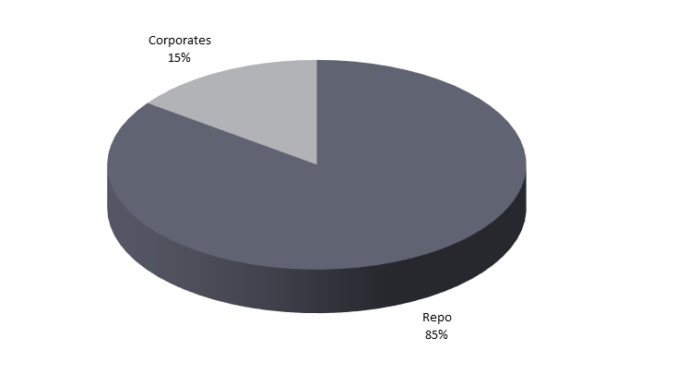
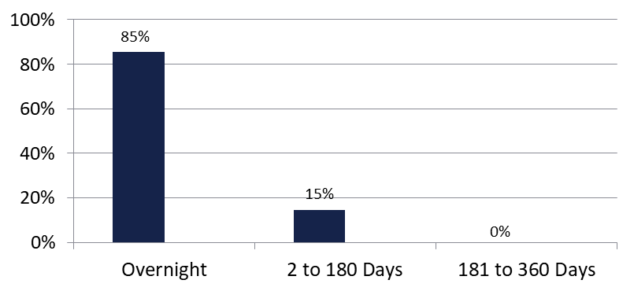

Securities Lending - Cash Collateral Portfolio
As of April 30, 2026
Portfolio Characteristics
Credit Quality (S&P) | % of Cost | Cost (in mil.)
U.S. Govt. Securities* | 85.34% | $325.0
AAA | 0% | $0
AA | 11.51% | $43.8
A | 3.15% | $12.0
Total Market Value $380.8 million
NAV 1.0001
Yield (360 basis) 3.780%
WAM 15 days
* Includes Repos that are collateralized by U.S. Govt. Securities.
Asset Class
Final Maturity Schedule

