Slide 1
Florida State Treasury Investments
August 31, 2024

Slide 2
Treasury Investment Portfolio
 | August 31, 2024
Treasury Investment Portfolio
(Internally and Externally Managed Portfolios) | $63,799,728,691.23

Slide 3
Portfolio Allocation as of
August 31, 2024

Slide 4
Treasury Participants as of August 31, 2024

Slide 5
Net Earnings Rate
(past 12 months)
Rates are unaudited

Slide 6
Annualized Net Earnings Rate as of August 31, 2024
Rates are unaudited

Slide 7
Total Treasury Investment Portfolio Monthly Sector Distribution

Slide 8
Total Treasury Investment Portfolio
Quality Distribution
S&P Ratings
*Includes Repos collateralized with US Government securities

Slide 9
Total Treasury Investment Portfolio
Effective Duration

Slide 10
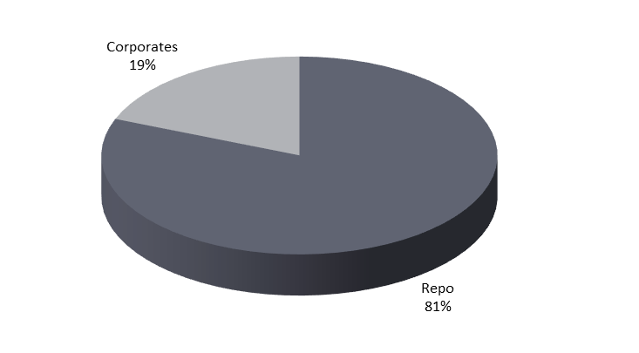
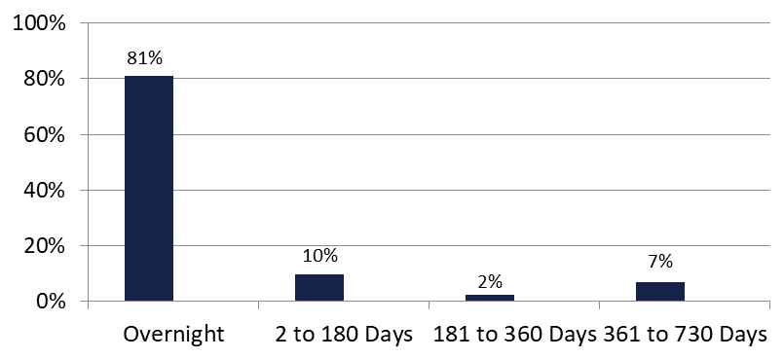

Securities Lending - Cash Collateral Portfolio As of August 31, 2024
Portfolio Characteristics
Credit Quality (S&P) | % of Cost | Cost (in mil.)
U.S. Govt. Securities* | 81.16% | $2,881.4
AAA | 0% | $0
AA | 6.43% | $228.3
A | 12.41% | $440.6
Total Market Value $3,550.3 million
NAV 1.0000
Yield (360 basis) 5.403%
WAM 51 days
* Includes Repos that are collateralized by U.S. Govt. Securities.
Asset Class
Final Maturity Schedule

