Slide 1
Florida State Treasury Investments
August 31, 2025

Slide 2
Treasury Investment Portfolio
 | August 31, 2025
Treasury Investment Portfolio
(Internally and Externally Managed Portfolios) | $61,571,666,930.46

Slide 3
Portfolio Allocation as of
August 31, 2025

Slide 4
Treasury Participants
as of August 31, 2025

Slide 5
Net Earnings Rate
(past 12 months)

Slide 6
Annualized Net Earnings Rate
as of August 31, 2025

Slide 7
Total Treasury Investment Portfolio Monthly Sector Distribution

Slide 8
Total Treasury Investment Portfolio
Quality Distribution

Slide 9
Total Treasury Investment Portfolio
Effective Duration

Slide 10
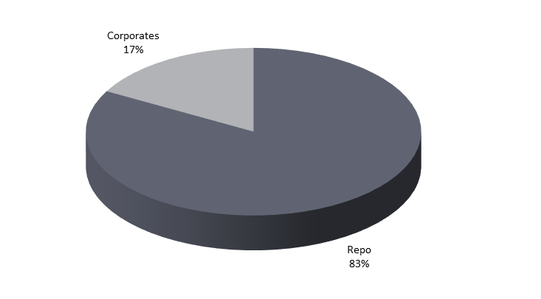
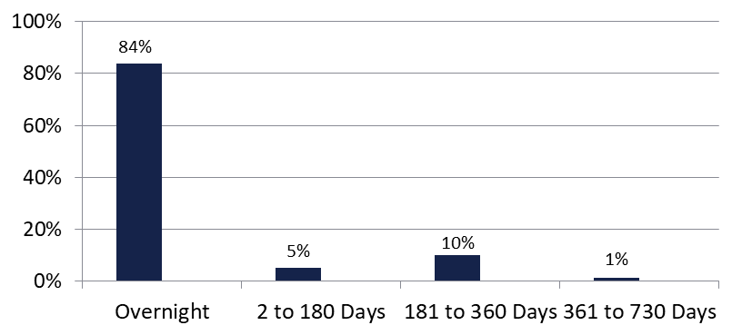

Securities Lending - Cash Collateral Portfolio
As of August 31 , 2025
Portfolio Characteristics
Credit Quality (S&P) | % of Cost | Cost (in mil.)
U.S. Govt. Securities* | 83.36% | $1,201.1
AAA | 0% | $0
AA | 9.86% | $142.1
A | 6.78% | $97.6
Total Market Value $1,440.8 million
NAV 1.0002
Yield (360 basis) 4.433%
WAM 37 days
* Includes Repos that are collateralized by U.S. Govt. Securities.
Asset Class
Final Maturity Schedule

