Slide 1
Florida State Treasury Investments
August 31, 2026

Slide 2
Treasury Investment Portfolio
 | August 31, 2026
Treasury Investment Portfolio
(Internally and Externally Managed Portfolios) | $59,514,047,874.22

Slide 3
Portfolio Allocation as of
August 31, 2026

Slide 4
Treasury Participants
as of August 31, 2026

Slide 5
Net Earnings Rate
(past 12 months)

Slide 6
Annualized Net Earnings Rate
as of August 31, 2026

Slide 7
Total Treasury Investment Portfolio Monthly Sector Distribution

Slide 8
Total Treasury Investment Portfolio
Quality Distribution

Slide 9
Total Treasury Investment Portfolio
Effective Duration

Slide 10
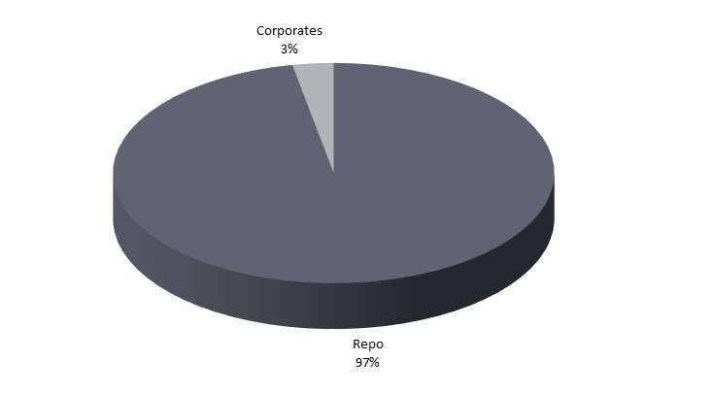

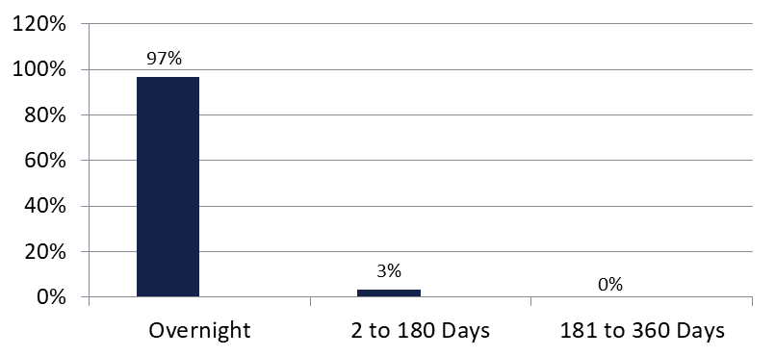
Securities Lending - Cash Collateral Portfolio
As of August 31, 2026
Portfolio Characteristics
Credit Quality (S&P) | % of Cost | Cost (in mil.)
U.S. Govt. Securities* | 96.78% | $595.8
AAA | 0% | $0
AA | 3.22% | $19.8
A | 0% | $0.00
Total Market Value $615.6 million
NAV 1.0000
Yield (360 basis) 3.745%
WAM 3 days
* Includes Repos that are collateralized by U.S. Govt. Securities.
Asset Class
Final Maturity Schedule

