Slide 1
Florida State Treasury Investments
September 30, 2025

Slide 2
Treasury Investment Portfolio
 | September 30, 2025
Treasury Investment Portfolio
(Internally and Externally Managed Portfolios) | $61,227,495,934.06

Slide 3
Portfolio Allocation as of
September 30, 2025

Slide 4
Treasury Participants
as of September 30, 2025

Slide 5
Net Earnings Rate
(past 12 months)

Slide 6
Annualized Net Earnings Rate
as of September 30, 2025

Slide 7
Total Treasury Investment Portfolio Monthly Sector Distribution

Slide 8
Total Treasury Investment Portfolio
Quality Distribution

Slide 9
Total Treasury Investment Portfolio
Effective Duration

Slide 10
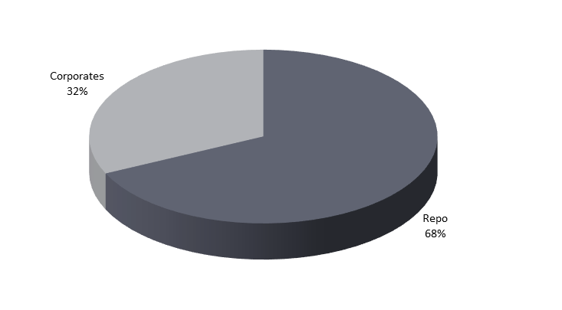
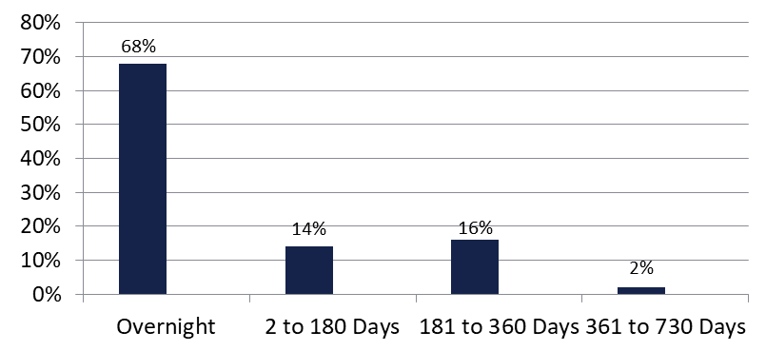

Securities Lending - Cash Collateral Portfolio
As of September 30, 2025
Portfolio Characteristics
Credit Quality (S&P) | % of Cost | Cost (in mil.)
U.S. Govt. Securities* | 67.76% | $484.9
AAA | 0% | $0
AA | 19.85% | $142.0
A | 12.39% | $88.6
Total Market Value $715.5 million
NAV 1.0004
Yield (360 basis) 4.353%
WAM 61 days
* Includes Repos that are collateralized by U.S. Govt. Securities.
Asset Class
Final Maturity Schedule

