Slide 1
Florida State Treasury Investments
October 31, 2025

Slide 2
Treasury Investment Portfolio
 | October 31, 2025
Treasury Investment Portfolio
(Internally and Externally Managed Portfolios) | $59,765,518,082.36

Slide 3
Portfolio Allocation as of
October 31, 2025

Slide 4
Treasury Participants
as of October 31, 2025

Slide 5
Net Earnings Rate
(past 12 months)

Slide 6
Annualized Net Earnings Rate
as of October 31, 2025

Slide 7
Total Treasury Investment Portfolio Monthly Sector Distribution

Slide 8
Total Treasury Investment Portfolio
Quality Distribution

Slide 9
Total Treasury Investment Portfolio
Effective Duration

Slide 10
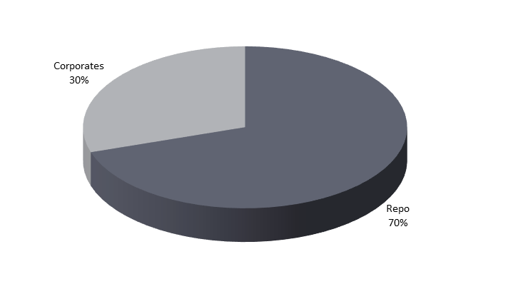
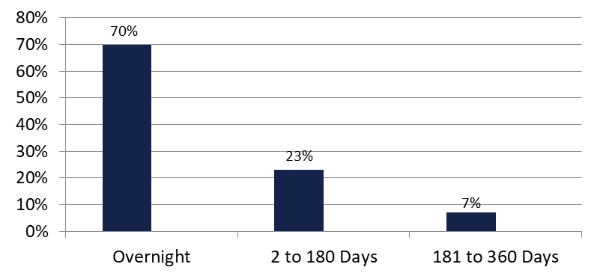

Securities Lending - Cash Collateral Portfolio
As of October 31, 2025
Portfolio Characteristics
Credit Quality (S&P) | % of Cost | Cost (in mil.)
U.S. Govt. Securities* | 69.63% | $516.3
AAA | 0% | $0
AA | 18.42% | $136.6
A | 11.95% | $88.6
Total Market Value $741.5 million
NAV 1.0003
Yield (360 basis) 4.351%
WAM 51 days
* Includes Repos that are collateralized by U.S. Govt. Securities.
Asset Class
Final Maturity Schedule

