Slide 1
Florida State Treasury Investments
November 30, 2024

Slide 2
Treasury Investment Portfolio
 | November 30, 2024
Treasury Investment Portfolio
(Internally and Externally Managed Portfolios) | $61,754,344,885.65

Slide 3
Portfolio Allocation as of
November 30, 2024

Slide 4
Treasury Participants as of November 30, 2024

Slide 5
Net Earnings Rate
(past 12 months)
Rates are unaudited

Slide 6
Annualized Net Earnings Rate as of November 30, 2024
Rates are unaudited

Slide 7
Total Treasury Investment Portfolio Monthly Sector Distribution

Slide 8
Total Treasury Investment Portfolio
Quality Distribution
S&P Ratings
*Includes Repos collateralized with US Government securities

Slide 9
Total Treasury Investment Portfolio
Effective Duration

Slide 10
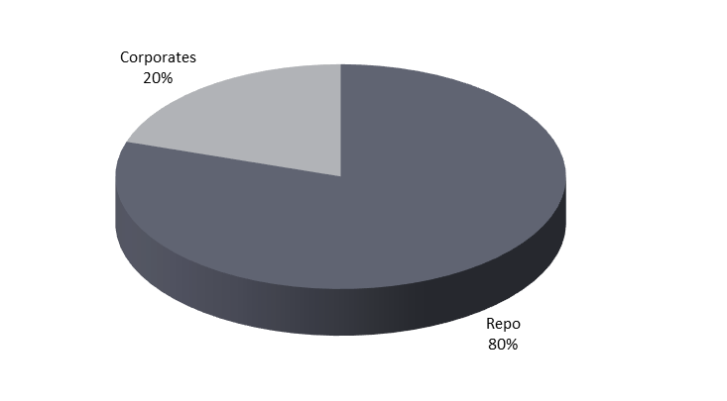
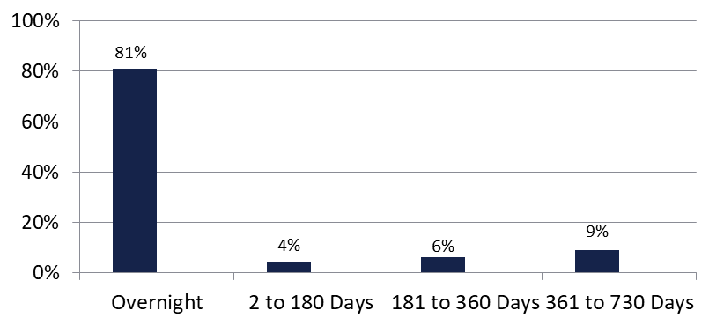

Securities Lending - Cash Collateral Portfolio As of November 30, 2024
Portfolio Characteristics
Credit Quality (S&P) | % of Cost | Cost (in mil.)
U.S. Govt. Securities* | 79.74% | $1,976.2
AAA | 0% | $0
AA | 7.87% | $195.1
A | 12.39% | $307.2
Total Market Value $2,478.5 million
NAV 1.0001
Yield (360 basis) 4.693%
WAM 65 days
* Includes Repos that are collateralized by U.S. Govt. Securities.
Asset Class
Final Maturity Schedule

