Slide 1
Florida State Treasury Investments
November 30, 2025

Slide 2
Treasury Investment Portfolio
 | November 30, 2025
Treasury Investment Portfolio
(Internally and Externally Managed Portfolios) | $59,971,942,457.19

Slide 3
Portfolio Allocation as of
November 30, 2025

Slide 4
Treasury Participants
as of November 30, 2025

Slide 5
Net Earnings Rate
(past 12 months)

Slide 6
Annualized Net Earnings Rate
as of November 30, 2025

Slide 7
Total Treasury Investment Portfolio Monthly Sector Distribution

Slide 8
Total Treasury Investment Portfolio
Quality Distribution

Slide 9
Total Treasury Investment Portfolio
Effective Duration

Slide 10
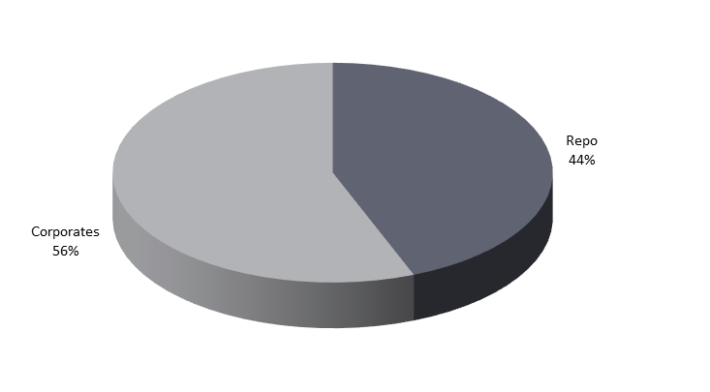
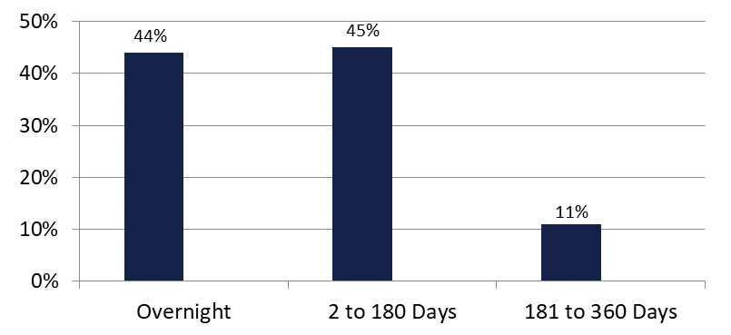

Securities Lending - Cash Collateral Portfolio
As of November 30, 2025
Portfolio Characteristics
Credit Quality (S&P) | % of Cost | Cost (in mil.)
U.S. Govt. Securities* | 44.47% | $180.4
AAA | 0% | $0
AA | 33.68% | $136.6
A | 21.85% | $88.6
Total Market Value $405.6 million
NAV 1.0005
Yield (360 basis) 4.275%
WAM 73 days
* Includes Repos that are collateralized by U.S. Govt. Securities.
Asset Class
Final Maturity Schedule

