Slide 1
Florida State Treasury Investments
December 31, 2024

Slide 2
Treasury Investment Portfolio
 | December 31, 2024
Treasury Investment Portfolio
(Internally and Externally Managed Portfolios) | $61,692,802,020.27

Slide 3
Portfolio Allocation as of
December 31, 2024

Slide 4
Treasury Participants as of December 31, 2024

Slide 5
Net Earnings Rate
(past 12 months)
Rates are unaudited

Slide 6
Annualized Net Earnings Rate as of December 31, 2024
Rates are unaudited

Slide 7
Total Treasury Investment Portfolio Monthly Sector Distribution

Slide 8
Total Treasury Investment Portfolio
Quality Distribution
S&P Ratings
*Includes Repos collateralized with US Government securities

Slide 9
Total Treasury Investment Portfolio
Effective Duration

Slide 10
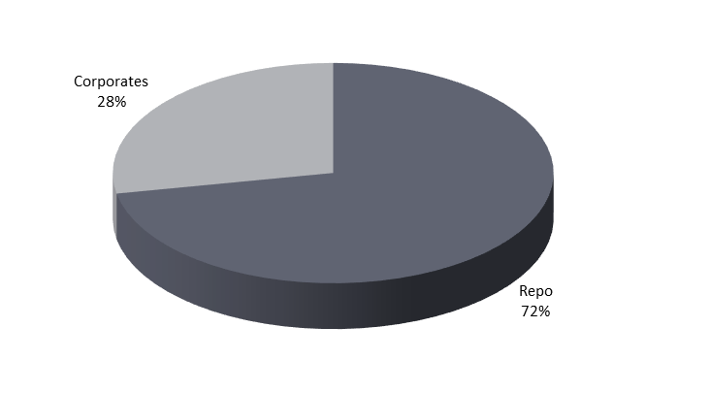
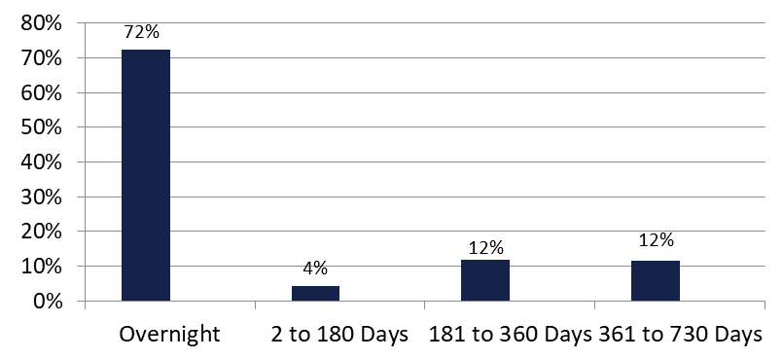

Securities Lending - Cash Collateral Portfolio As of December 31, 2024
Portfolio Characteristics
Credit Quality (S&P) | % of Cost | Cost (in mil.)
U.S. Govt. Securities* | 72.48% | $1,13.4
AAA | 0% | $0
AA | 12.82% | $195.1
A | 14.70% | $223.8
Total Market Value $1,522.3 million
NAV 1.0004
Yield (360 basis) 4.569%
WAM 95 days
* Includes Repos that are collateralized by U.S. Govt. Securities.
Asset Class
Final Maturity Schedule

