Slide 1

EDI Basic Training

Slide 2
Florida Division of Workers’ Compensation
Claims EDI Release 3 Training for Trading Partners
In Release 3 EDI, all data is sent electronically via a FROI or SROI transaction.
FROI (First Report of Injury)
SROI (Subsequent Report of Injury)

Slide 3
Florida Division of Workers’ Compensation
Claims EDI Release 3 Training for Trading Partners
What is an MTC?
Maintenance Type Code
A code that defines the specific purpose of each transaction being transmitted.

Slide 4
Florida Division of Workers’ Compensation
Claims EDI Release 3 Training for Trading Partners
First Report
of Injury
MTCs

Slide 5
Florida Division of Workers’ Compensation
Claims EDI Release 3 Training for Trading Partners
Florida FROI MTCs include:
00 – Original
04 – Total Denial
01 – Cancel (Claim Filed in Error)
AQ – Acquired Claim
AU – Acquired First Report

Slide 6

Florida Division of Workers’ Compensation
Claims EDI Release 3 Training for Trading Partners
Florida FROI MTC Changes:
02 - Change

Slide 7
Florida Division of Workers’ Compensation
Claims EDI Release 3 Training for Trading Partners
Subsequent Report
of Injury
MTCs

Slide 8

Florida Division of Workers’ Compensation
Claims EDI Release 3 Training for Trading Partners
Florida SROI MTCs include Initial Payment equivalents:
IP – Initial Payment
PY – Payment
EP – Employer Paid Salary in Lieu of Com
AP – Acquired First Payment
(cont’d…)

Slide 9

Florida Division of Workers’ Compensation
Claims EDI Release 3 Training for Trading Partners
Florida SROI MTCs include Initial Payment equivalents:
CD – Compensable Death-No Known Dependents/Payees
VE - Volunteer

Slide 10

Florida Division of Workers’ Compensation
Claims EDI Release 3 Training for Trading Partners
Florida SROI MTCs include Denials:
04 – Full Denial
PD – Partial Denial (Indemnity Only and other required partial denials)

Slide 11

Florida Division of Workers’ Compensation
Claims EDI Release 3 Training for Trading Partners
Florida SROI MTC Additions/Changes:
AB – Concurrent Benefit
CA – Change in Benefit Amount
CB - Change in Benefit Type

Slide 12

Florida Division of Workers’ Compensation
Claims EDI Release 3 Training for Trading Partners
Florida SROI MTC Reinstatements:
RB – Reinstatement of Benefits
ER – Employer Reinstatement

Slide 13

Florida Division of Workers’ Compensation
Claims EDI Release 3 Training for Trading Partners
Florida SROI MTC Indemnity Suspensions:
S1 – RTW or Released to RTW
S2 – Medical Non-Compliance
S3 – Administrative Non-Compliance
S4 – Claimant Death
S5 – Incarceration
(cont’d…)

Slide 14
Florida Division of Workers’ Compensation
Claims EDI Release 3 Training for Trading Partners
Florida SROI MTC Indemnity Suspensions:
S6 – Claimant’s Whereabouts Unknown
S7 – Benefits Exhausted
S8 – Jurisdiction Change
P7 – Benefits Exhausted (This is reported when PT Supp benefits are suspended but PT benefits continue.)

Slide 15

Florida Division of Workers’ Compensation
Claims EDI Release 3 Training for Trading Partners
Florida SROI MTC Periodic Reports:
SA – Sub-Annual
FN – Final

Slide 16

Florida Division of Workers’ Compensation
Claims EDI Release 3 Training for Trading Partners
Florida SROI MTC Changes:
02 - Change

Slide 17

Florida Division of Workers’ Compensation
Claims EDI Release 3 Training for Trading Partners
What is a Benefit Type Code (BTC)?
A code that identifies the type of indemnity benefits being paid.

Slide 18
Florida Division of Workers’ Compensation
Claims EDI Release 3 Training for Trading Partners
Benefit Type Codes include:
051 – Temporary Total Catastrophic
070 – Temporary Partial
090 – Permanent Partial Disfigurement
410 – Voc Rehab Maintenance
500 – Unspecified Lump Sum Pmt/Settlement
(cont’d…)

Slide 19
Florida Division of Workers’ Compensation
Claims EDI Release 3 Training for Trading Partners
Benefit Type Codes include:
5xx – Unspecified Lump Sum Pmt/Settlement per
Benefit Type Code (e.g., 510, 550, etc.)
210 – Employer Paid Fatal (Death)
230 – Employer Paid Perm Partial (IBs)
240 – Employer Paid Unspecified
(cont’d…)

Slide 20
Florida Division of Workers’ Compensation
Claims EDI Release 3 Training for Trading Partners
Benefit Type Codes include:
242 – Employer Paid Unspecified
250 – Employer Paid Temporary Total
251 – Employer Paid Temporary Total Catastrophic
270 – Employer Paid Temporary Partial

Slide 21


Florida Division of Workers’ Compensation
Claims EDI Release 3 Training for Trading Partners
What are Other Benefit Type Codes (OBTs)?
Codes that represent the type of non-indemnity benefits being paid.

Slide 22
Florida Division of Workers’ Compensation
Claims EDI Release 3 Training for Trading Partners
Florida Required Other Benefit Type Codes:
300 – Total Funeral Expenses
310 – Total Penalties
311 – Total Employee Penalties
320 – Total Interest
321 – Total Employee Interest
(cont’d…)

Slide 23
Florida Division of Workers’ Compensation
Claims EDI Release 3 Training for Trading Partners
Florida Required Other Benefit Type Codes:
370 – Total Other Medical
380 – Total Voc Rehab Evaluation
390 – Total Voc Rehab Education
400 – Total Other Voc Rehab
430 – Total Unallocated Prior Indemnity Benefits (acquired claims)
475 – Total Medical Travel Expenses

Slide 24

Florida Division of Workers’ Compensation
Claims EDI Release 3 Training for Trading Partners
Event Benefits Segment

Slide 25

Florida Division of Workers’ Compensation
Claims EDI Release 3 Training for Trading Partners
Event Benefits Segment Rules
If required, claim administrators must be prepared to send all data elements in the Benefits Segment on the Benefit Segment Requirements worksheet of the Florida Element Requirement Table.

Slide 26
Florida Division of Workers’ Compensation
Claims EDI Release 3 Training for Trading Partners
Event Benefits Segment Rules
An Event Benefits Segment must and will include the following data elements:
MTC
Gross Weekly Amount
Gross Weekly Amount Effective Date
(cont’d…)

Slide 27

Florida Division of Workers’ Compensation
Claims EDI Release 3 Training for Trading Partners
Event Benefits Segment Rules
An Event Benefits Segment must and will include the following data elements:
Net Weekly Amount
Net Weekly Amount Effective Date
Benefit Type Code
(cont’d…)

Slide 28

Florida Division of Workers’ Compensation
Claims EDI Release 3 Training for Trading Partners
Event Benefits Segment Rules
An Event Benefits Segment must and will include the following data elements:
Benefit Period Start Date
Benefit Period Through Date
Benefit Type Claim Weeks
(cont’d…)

Slide 29
Florida Division of Workers’ Compensation
Claims EDI Release 3 Training for Trading Partners
Event Benefits Segment Rules
An “Event” Benefits Segment must and will include the following data elements:
Benefit Type Claim Days
Benefit Type Amount Paid
Benefit Payment Issue Date (MTC IP, AP, PY with BTC 0xx only)

Slide 30
Florida Division of Workers’ Compensation
Claims EDI Release 3 Training for Trading Partners
Event Benefits Segment Rules
When a benefit type is affected by the Event being reported, the MTC is sent in the Benefits Segment of the Benefit that is being:
started, changed (to/from), suspended –OR-
when reporting a lump sum payment with Benefit Type Code 0xx.

Slide 31
Florida Division of Workers’ Compensation
Claims EDI Release 3 Training for Trading Partners
Event Benefits Segment Rules
When a benefit type is not affected by the Event being reported (older/previously reported benefits), the MTC is not required to be sent in the Benefits Segment for the older/previously reported benefit type(s). This is called a Sweep Benefits Segment and is outlined later in this presentation.

Slide 32
Florida Division of Workers’ Compensation
Claims EDI Release 3 Training for Trading Partners
MTCs that will contain “Event” Benefits Segment(s):
AB – Add Concurrent Benefit Type
AP – Acquired Payment
CB – Change in Benefit Type
EP – Employer Paid
IP – Initial Payment
RB – Reinstatement of Benefits

Slide 33
Florida Division of Workers’ Compensation
Claims EDI Release 3 Training for Trading Partners
MTCs that will contain “Event” Benefits Segment(s):
PY – Payment Report with BTC 0xx only (when the lump sum payment specifies a rate and time)
CA – Change in Benefit Amount
SROI 02 – Change (data is changing in Benefits Segment)
(cont’d…)

Slide 34

Florida Division of Workers’ Compensation
Claims EDI Release 3 Training for Trading Partners
MTCs that will contain “Event” Benefits Segment(s):
P7 – Partial Suspension (PT Supp benefits)
Sx (S1 - S8) - Suspension

Slide 35

Florida Division of Workers’ Compensation
Claims EDI Release 3 Training for Trading Partners
In Florida, when an MTC is placed in a Benefits Segment, it is edited as an “Event” Benefits Segment requiring Gross and Net Weekly Amounts, effective dates and the Benefit Payment Issue Date (when required).

Slide 36
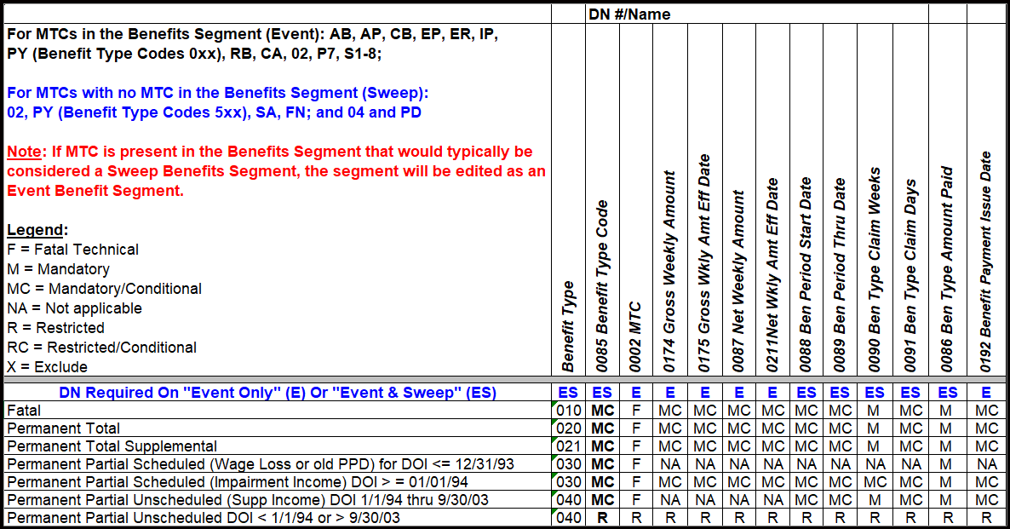
Florida Division of Workers’ Compensation
Claims EDI Release 3 Training for Trading Partners

Slide 37

Florida Division of Workers’ Compensation
Claims EDI Release 3 Training for Trading Partners
Sweep Benefits Segment

Slide 38

Florida Division of Workers’ Compensation
Claims EDI Release 3 Training for Trading Partners
Sweep Benefits Segment Rules
A “Sweep” Benefits Segment must and will only include the following data elements:
Benefit Type Code
Benefit Period Start Date
Benefit Period Through Date
(cont’d…)

Slide 39


Florida Division of Workers’ Compensation
Claims EDI Release 3 Training for Trading Partners
Sweep Benefits Segment Rules
Benefit Claim Weeks
Benefit Claim Days
Benefit Type Amount Paid

Slide 40

Florida Division of Workers’ Compensation
Claims EDI Release 3 Training for Trading Partners
Sweep Benefits Segment Rules
A “Sweep” Benefits Segment will not include the following:
MTC
Gross Weekly Amount
Gross Weekly Amount Effective Date
(cont’d…)

Slide 41

Florida Division of Workers’ Compensation
Claims EDI Release 3 Training for Trading Partners
Sweep Benefits Segment Rules
Net Weekly Amount
Net Weekly Amount Effective Date
Benefit Payment Issue Date

Slide 42
Florida Division of Workers’ Compensation
Claims EDI Release 3 Training for Trading Partners
The following MTCs will not contain an Event Benefits Segment:
SROI 02 – Change (when no change Event is occurring in the Benefits Segment)
SROI 04 – Denial
PD – Partial Denial
(cont’d..)

Slide 43

Florida Division of Workers’ Compensation
Claims EDI Release 3 Training for Trading Partners
SA – Sub-Annual
FN - Final

Slide 44

Florida Division of Workers’ Compensation
Claims EDI Release 3 Training for Trading Partners
REMINDER
If an MTC is present in a Benefits Segment that would typically be considered a Sweep Benefits Segment, Florida will edit the segment as an Event Benefits Segment.

Slide 45

Florida Division of Workers’ Compensation
Claims EDI Release 3 Training for Trading Partners
Sweep Benefits Segment Rules
Sweep Benefit Segment(s) will be sent along with an Event Benefit Segment(s) if older/previously reported benefits are not a part of the Event that is currently being reported.

Slide 46

Florida Division of Workers’ Compensation
Claims EDI Release 3 Training for Trading Partners
Sweep Benefits Segment Rules
Example - Benefit type changes from TP to IIBs
BTC | Benefit Type | MTC | Gross Weekly Amount | Gross Eff. Date | Net Weekly Amount | Net Eff. Date | Start Date | Through Date | Weeks | Days | Amount Paid | Payment Issue Date
050 | Temporary Total |  |  |  |  |  | 1/1/25 | 1/28/25 | 4 | 0 | 1,389.84
070 | Temporary Partial | CB | 333.57 | 1/29/25 | 333.57 | 1/29/25 | 1/29/25 | 2/11/25 | 2 | 0 | 667.14
030 | Perm Part Scheduled | CB | 130.30 | 2/15/25 | 130.30 | 2/15/25 | 2/15/25 | 2/28/25 | 2 | 0 | 260.60

Slide 47
Florida Division of Workers’ Compensation
Claims EDI Release 3 Training for Trading Partners

Slide 48

Insurer Reporting Services Section Contacts

Slide 49

Team Email Boxes
Centralized Performance System (CPS)
  M&ACPSPenaltySection@myfloridacfo.com
Claims EDI
  claims.edi@myfloridacfo.com
Claims EDI Triage
  TriageClaims.edi@myfloridacfo.com

Slide 50

Team Email Boxes
Medical EDI Team
  MedicalDataManagementTeam@myfloridacfo.com
Proof of Coverage EDI Team
  poc.edi@myfloridacfo.com

Slide 51
Contacts
Charlene Miller, Bureau Chief
Bureau of Monitoring & Audit (M&A)
Charlene.Miller@myfloridacfo.com / (850) 413-1738
Michelle Carter
Operations & Management Consultant Manager
Michelle.Carter@myfloridacfo.com / (850) 413-1701

Slide 52
Contacts
Leydia Alvarado (Research & Training Specialist)
Leydia.Alvarado@myfloridacfo.com / (850) 413-1709
Stasha Chaires (Claims EDI Analyst - Team Lead)
Stasha.Chaires@myfloridacfo.com / (850) 413-1746
Kim Farmer (Claims EDI Analyst)
Kimberly.Farmer@myfloridacfo.com / (850) 413-1899
Shatavia Meeks (Medical EDI Analyst)
Shatavia.Meeks@myfloridacfo.com / (850) 413-1653

Slide 53
Contacts
James Austin (CPS Supervisor)
James.Austin@myfloridacfo.com / (850) 413-1778
Linda Jefferson (CPS Analyst - Team Lead)
Linda.Jefferson@myfloridacfo.com / (850) 413-1774
Patience Aninakwa (CPS Analyst)
Patience.Aninakwa@myfloridacfo.com / (850) 413-1697
Johnny Session (CPS Analyst)
Johnny.Session@myfloridacfo.com / (850) 413-1748

Slide 54

Contacts
Tijuana Bell (CPS Analyst)
Tijuana.Bell@myfloridacfo.com / (850) 413-1908
Stephon Alvin, Jr. (CPS Analyst)
Stephon.AlvinJr@myfloridacfo.com / (850) 413-1785
JaNiyah Price (CPS Analyst)
JaNiyah.Price@myfloridacfo.com / (850) 413-1742

